Slide 1
End of Term Presentation
Winter 2023
Keven Qiu
04/17/23

Slide 2
About Me
3rd year undergraduate student at the University of Waterloo
Computer Science and Combinatorics & Optimization
3rd co-op term

Slide 3
Projects
Weight-Bearing Computed Tomography (WBCT) Bone Mineral Density (BMD) Measurement
Cone Beam CT Reconstruction Algorithm

Slide 4
WBCT BMD Measurement

Slide 5
Weight-Bearing CT & BMD Measurement
WBCT
Utilizes cone beam CT technique
Provides useful information for understanding diseases in load-bearing joints
Assesses bone when in use
Low radiation dose
Bone mineral density
Bone diseases such as osteoporosis
Bone fracture
Evaluate performance of bone-targeting therapies
Notes:
Slide for why we care about WBCT and why we want to measure BMD with WBCT.
Slide for objective: what are the questions we are trying to answer, feasibility of BMD measurement with WBCT compared to clinical CT, and sync vs async calibration.
Make questions

Slide 6
Objectives
Evaluate reliability of BMD measurement with WBCT in comparison to clinical CT
Evaluate BMD uniformity of WBCT
Feasibility of synchronous calibration to measure BMD using WBCT
Notes:
Slide for objective: what are the questions we are trying to answer, feasibility of BMD measurement with WBCT compared to clinical CT, and sync vs async calibration.

Slide 7
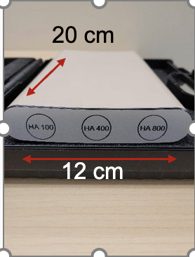
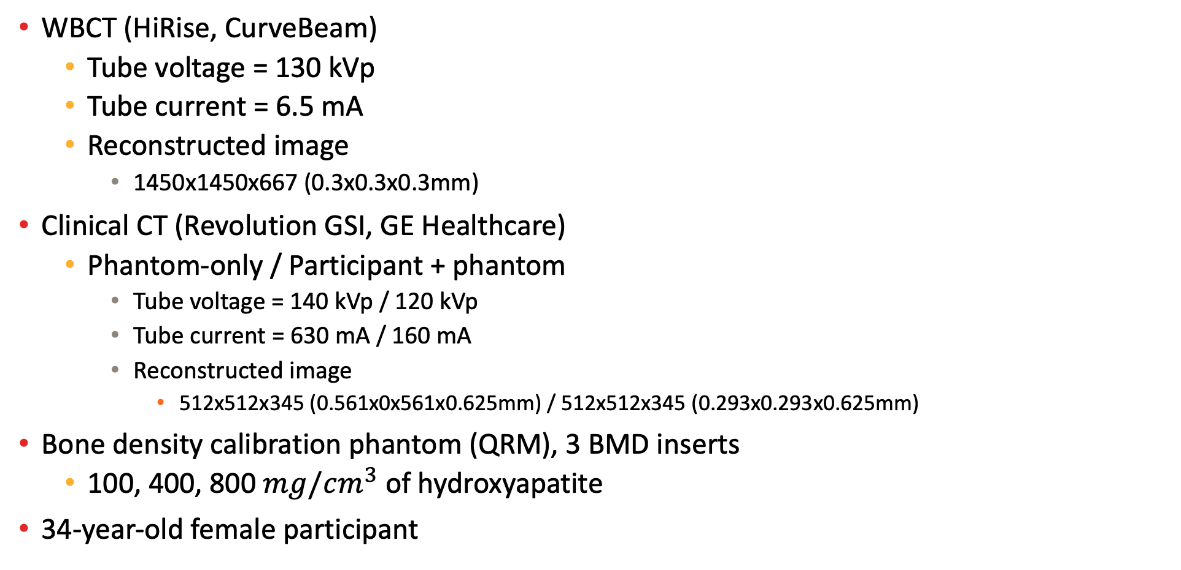
Materials
BDC Phantom
WBCT (HiRise, CurveBeam)
Tube voltage = 130 kVp
Tube current = 6.5 mA
Reconstructed image
1450x1450x667 (0.3x0.3x0.3mm)
Clinical CT (Revolution GSI, GE Healthcare)
Phantom-only / Participant + phantom
Tube voltage = 140 kVp / 120 kVp
Tube current = 630 mA / 160 mA
Reconstructed image
512x512x345 (0.561x0x561x0.625mm) / 512x512x345 (0.293x0.293x0.625mm)
Bone density calibration phantom (QRM), 3 BMD inserts
100, 400, 800 $mg/cm^{3}$ of hydroxyapatite
34-year-old female participant

Slide 8
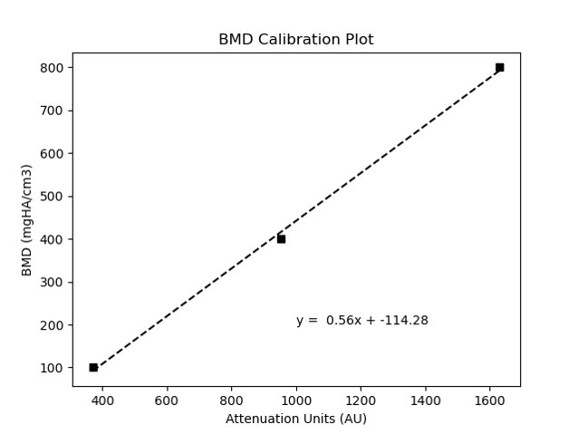
Calibration
Calibration is used in CT scanners to convert image measurements to a specified unit
The phantom is used to calibrate because of its known BMD inserts

Slide 9
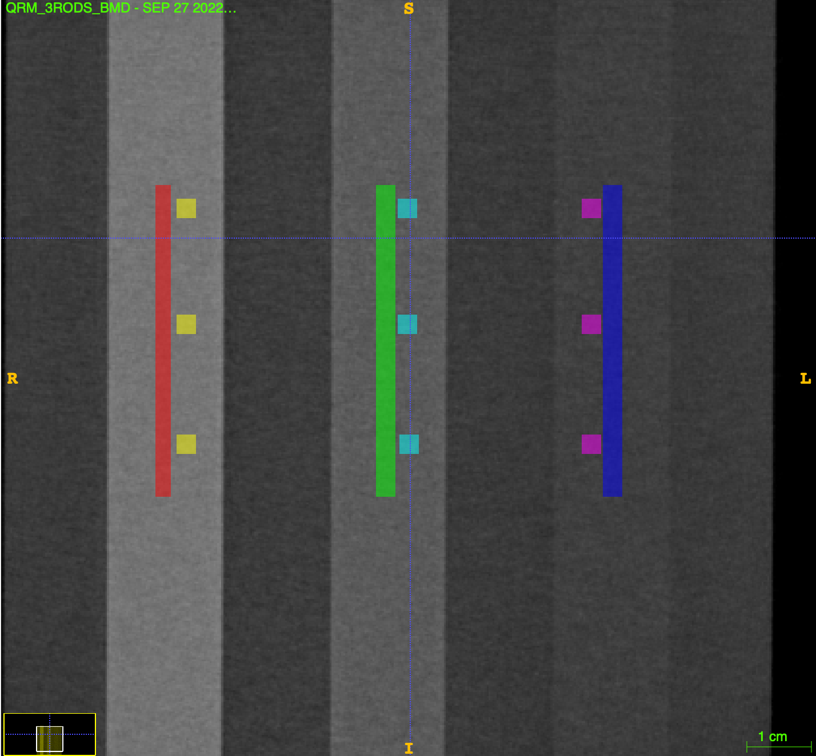
Methods
Four scans: WBCT phantom-only, WBCT participant + phantom, clinical CT phantom-only, clinical CT participant + phantom
Manual segmentation of 3 cylinders (1/BMD insert) of diameter 10 voxels and 9 cubes (3/BMD insert) of size 10x10x10 voxels
Use the cubes to get a calibration equation to BMD units
Notes:
Mention what WBCT scanner, what clinical CT scanner, what phantom, participant info
Make slide about what is calibration, why we need the phantom,

Slide 10
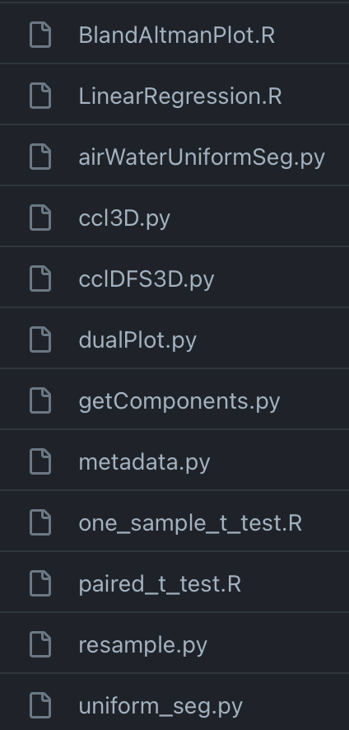
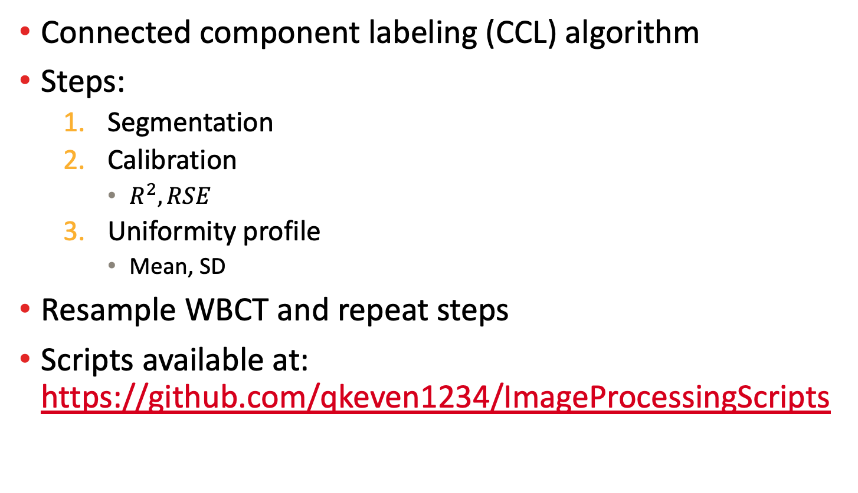
Methods Cont’d
Connected component labeling (CCL) algorithm
Steps:
Segmentation
Calibration
$R^{2}, RSE$
Uniformity profile
Mean, SD
Resample WBCT and repeat steps
Scripts available at: https://github.com/qkeven1234/ImageProcessingScripts
Notes:
Explain why CCL was needed, don’t explain every script, explain high level (put above in sequential order).
Steps and outcomes.

Slide 11
Methods Cont’d – Statistical Analysis
Performed one-sample t-test to test difference to true BMD value
Paired t-test to test differences between methods
Linear regression and Bland-Altman plot between methods

Slide 12
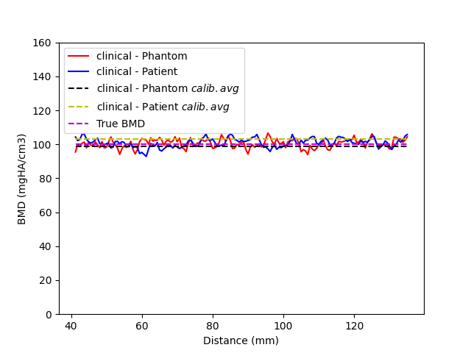
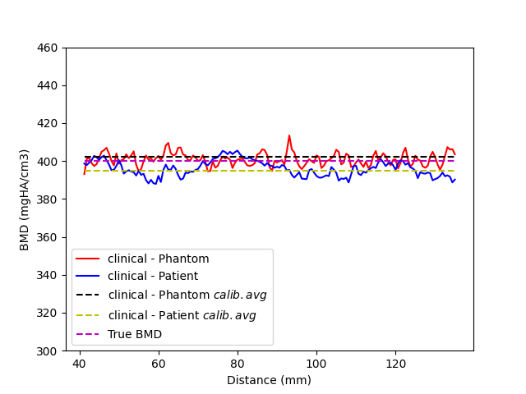
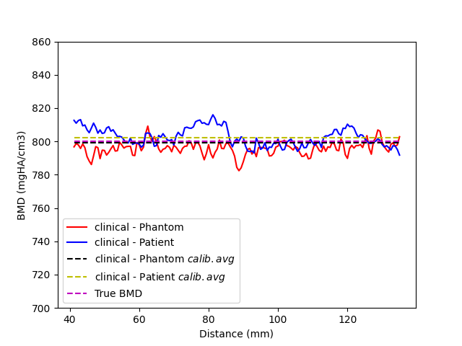
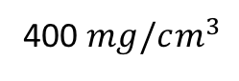
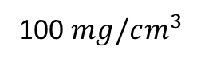
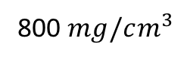
Results: Uniformity Profile – Clinical CT
Clinical CT is accurate and has low variability
100 $mg/cm^{3}$
400 $mg/cm^{3}$
800 $mg/cm^{3}$
Notes:
Make each image bigger

Slide 13
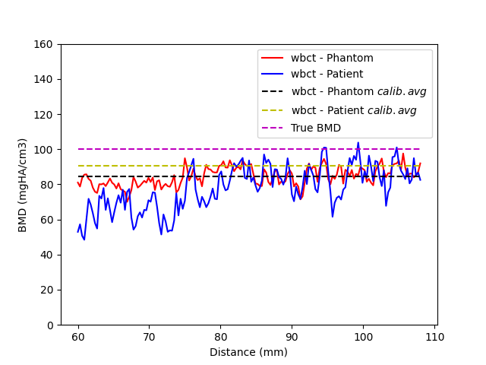
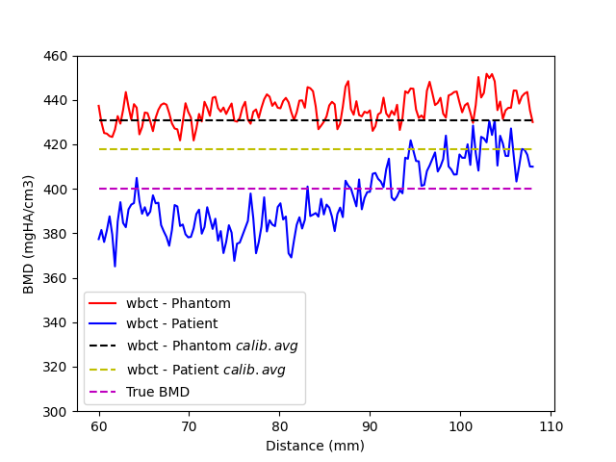
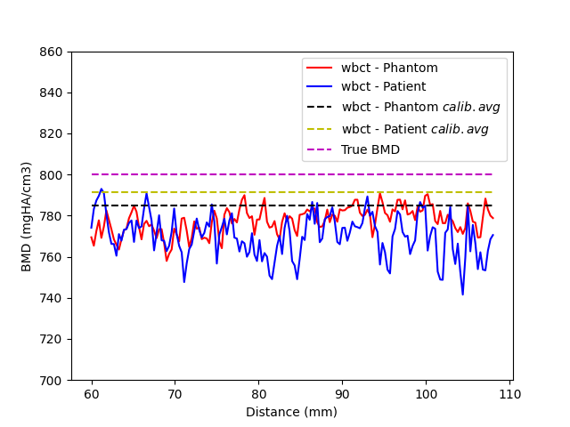
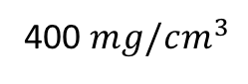
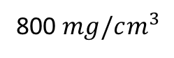
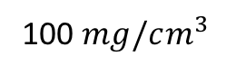
Results: Uniformity Profile – WBCT
Variation in participant scan since there is artefact present
Generally consistent about its calibrated mean
100 $mg/cm^{3}$
400 $mg/cm^{3}$
800 $mg/cm^{3}$
Notes:
Make each image bigger

Slide 14
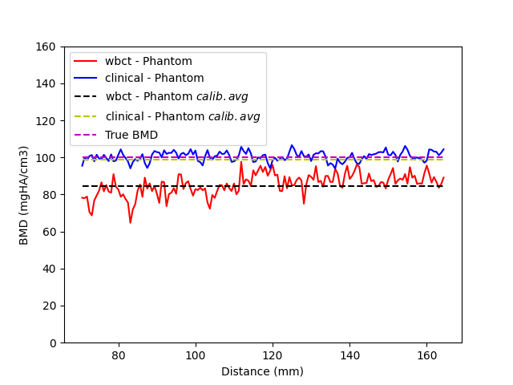
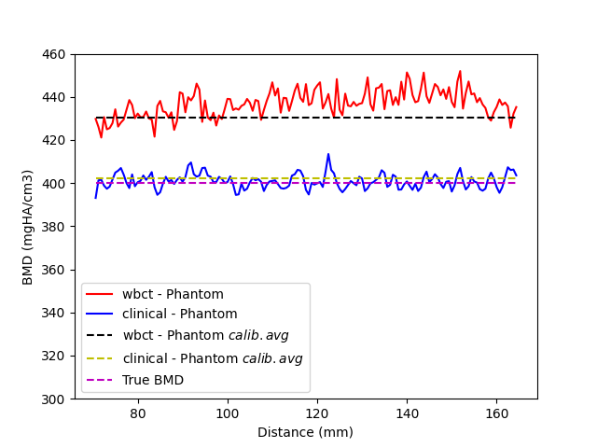
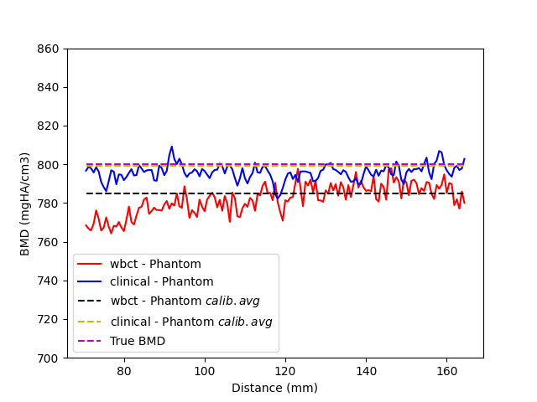
Results: Uniformity Profile – WBCT vs. Clinical CT Phantom-Only
WBCT < true BMD for 100, 800
WBCT > true BMD for 400
100 $mg/cm^{3}$
400 $mg/cm^{3}$
800 $mg/cm^{3}$
Notes:
Make each image bigger

Slide 15
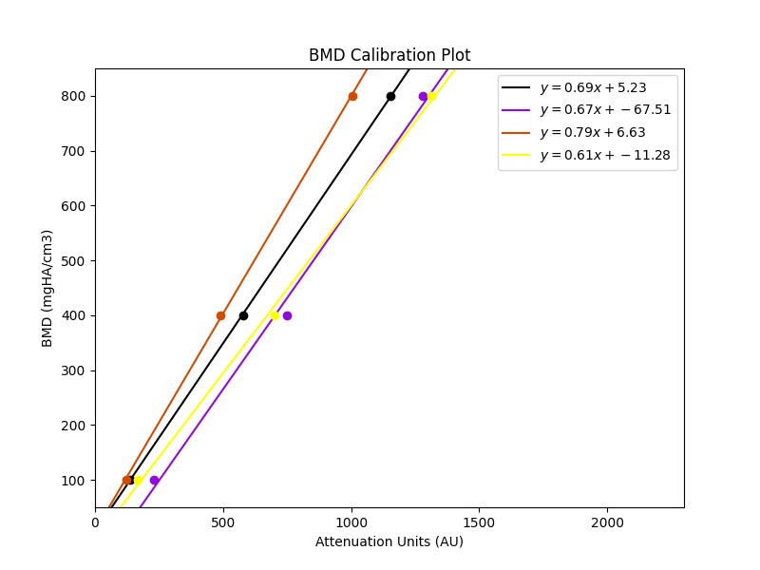
Image Statistics and Calibration Plot
CCT Phantom
WBCT Phantom
CCT Participant
WBCT Participant
CCT Phantom
WBCT Phantom
CCT Participant
WBCT Participant
Notes:
Only take R2 and RSE columns and colour code to plot.

Slide 16
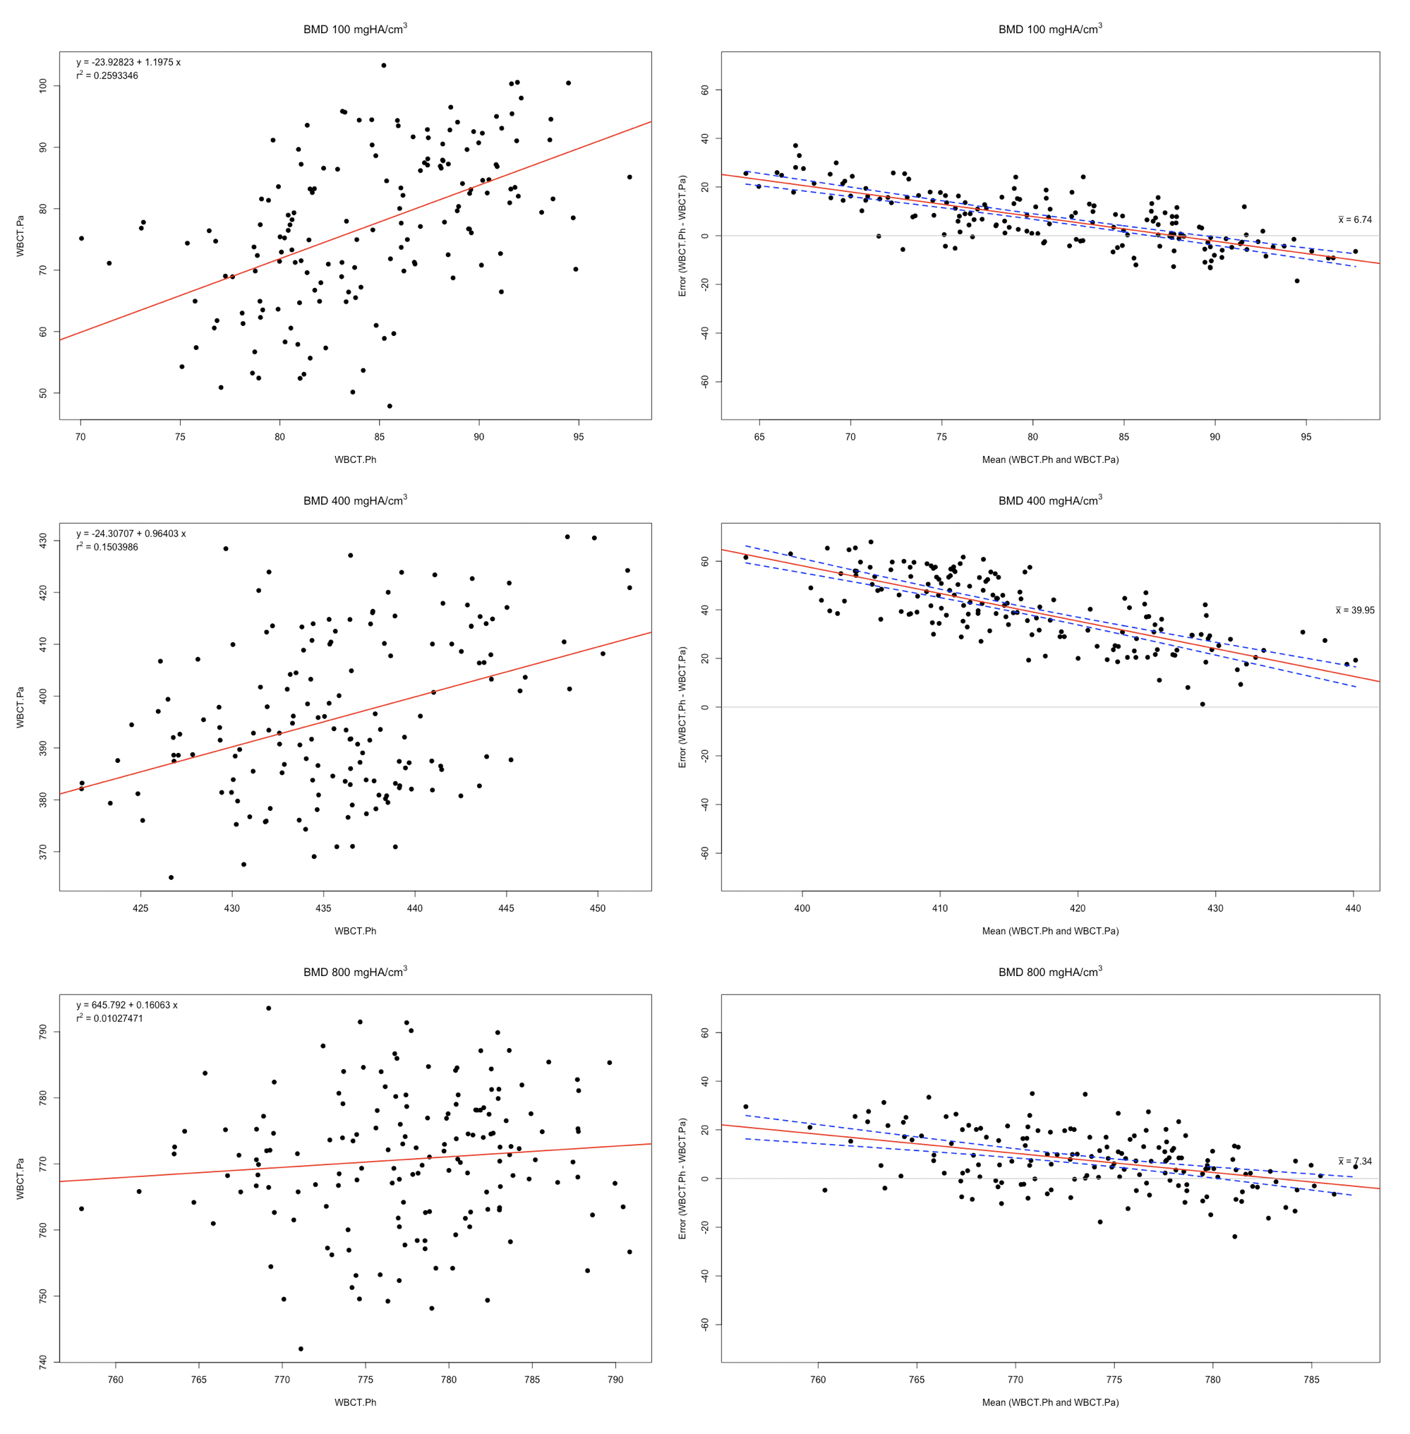
WBCT Phantom-Only vs WBCT Participant & Phantom
Notes:
Use response confidence interval for limits of agreement to see if there is a relationship between the mean quantity and the error.
Why we are using regression and bland altman.

Slide 17
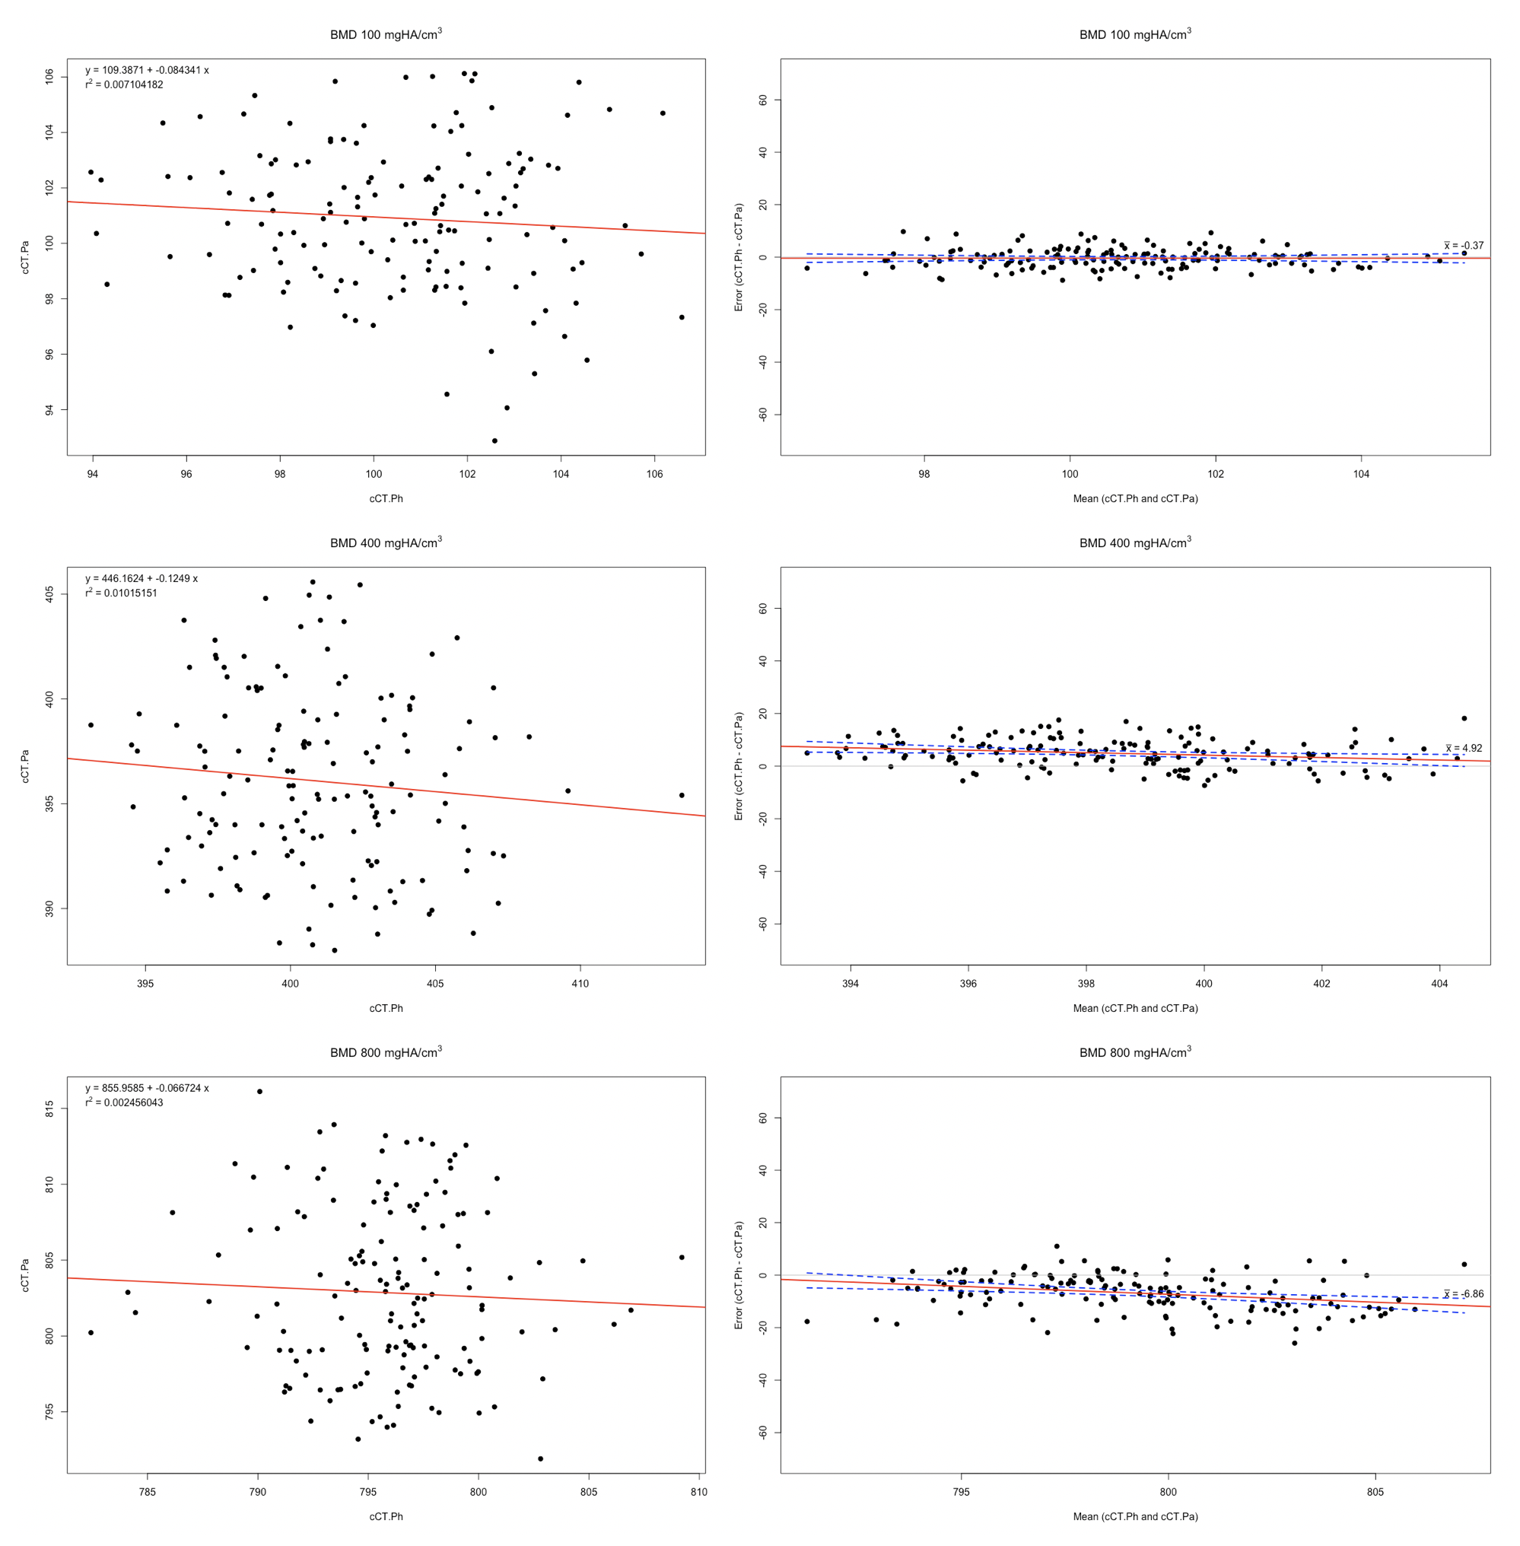
Clinical CT Phantom-Only vs Clinical CT Participant & Phantom

Slide 18
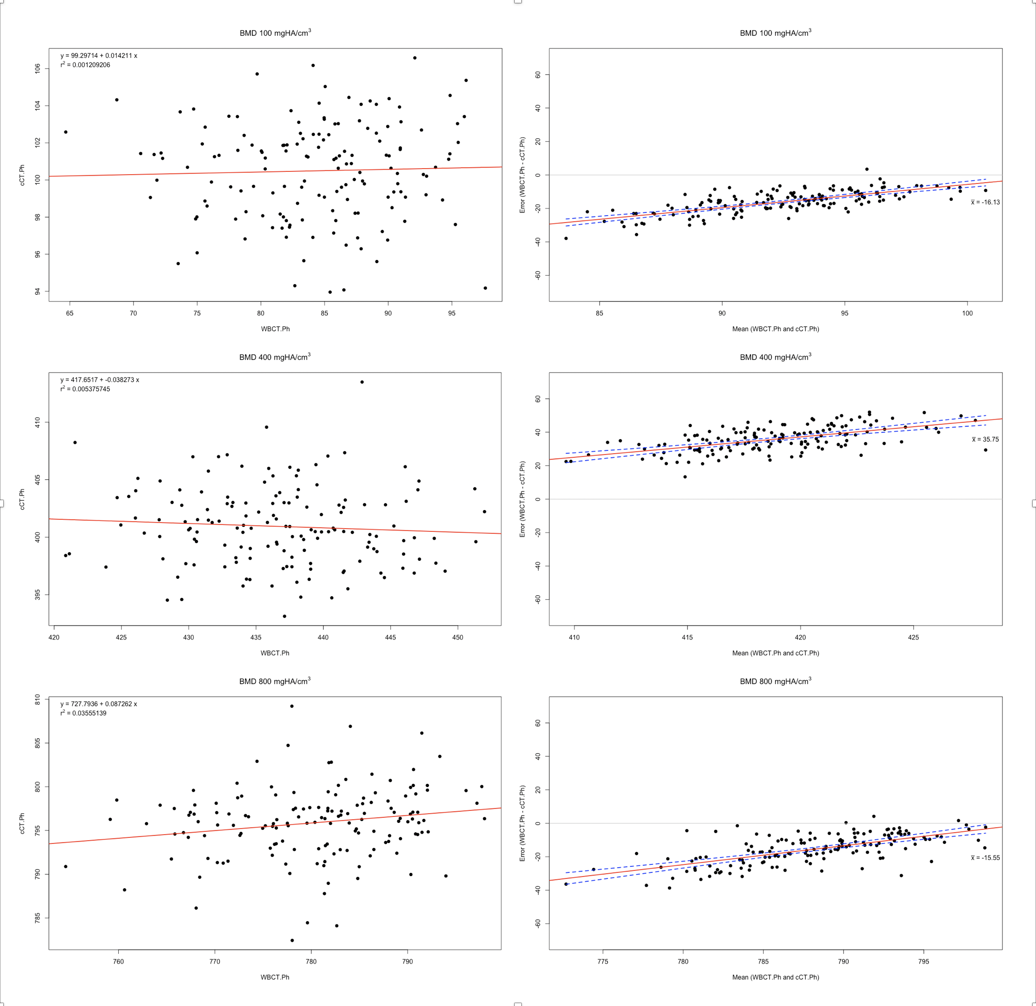
WBCT Phantom-Only vs Clinical CT Phantom-Only

Slide 19
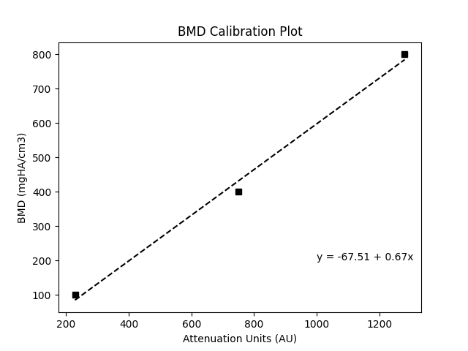
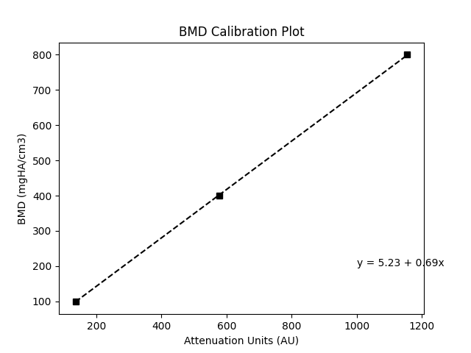
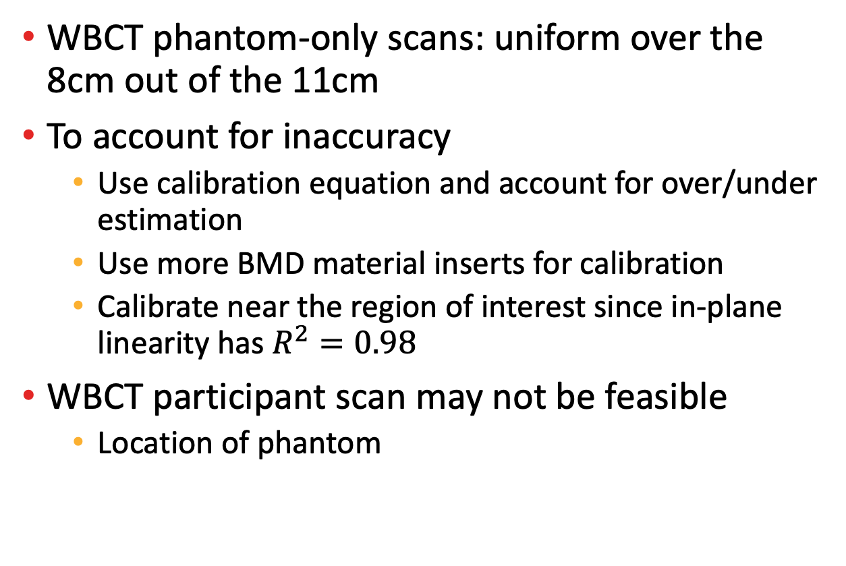
Interpretation and Improvement
WBCT BDC
WBCT phantom-only scans: uniform over the 8cm out of the 11cm
To account for inaccuracy
Use calibration equation and account for over/under estimation
Use more BMD material inserts for calibration
Calibrate near the region of interest since in-plane linearity has $R^{2}=0.98$
WBCT participant scan may not be feasible
Location of phantom
Clinical CT
Notes:
Bring back to questions: reliable and feasibility of sync and async
Take an individual calibration for wbct and clinical ct
WBCT is uniform over 8cm over the total of 11/19 cm.
Mention in-plane linearity. Try to calibrate closer axially since linearity is quite good = 0.98

Slide 20
Cone Beam CT Reconstruction

Slide 21
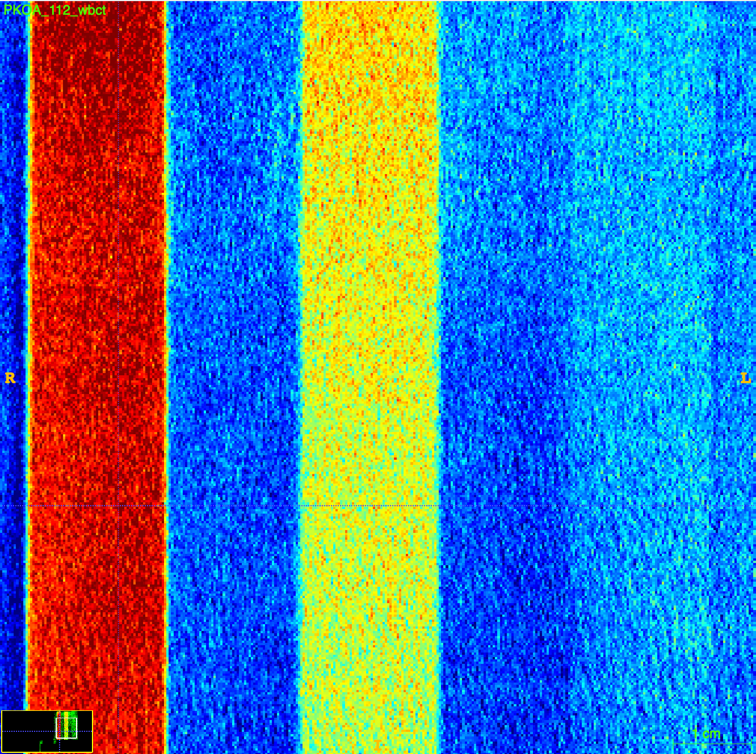
CT Reconstruction Intro
BMD in the reconstructed images for cone beam CT was slightly inaccurate and has higher variability
Control beam hardening correction
Achieve better BMD values
Better contrast between soft tissue and bone
Notes:
Why: Control beam hardening correction, BMD values, better contrast between soft tissue and bone (Mys).

Slide 22
CT Reconstruction
Mathematical algorithm that takes in projection data from X-ray at many different angles and outputs tomographic images
A sinogram is a collection of projections at different angles
Feed the sinogram data into the algorithm
Common technique is an analytic reconstruction: filtered back projection
Apply a filter to smooth the sinogram data and then back project

Slide 23
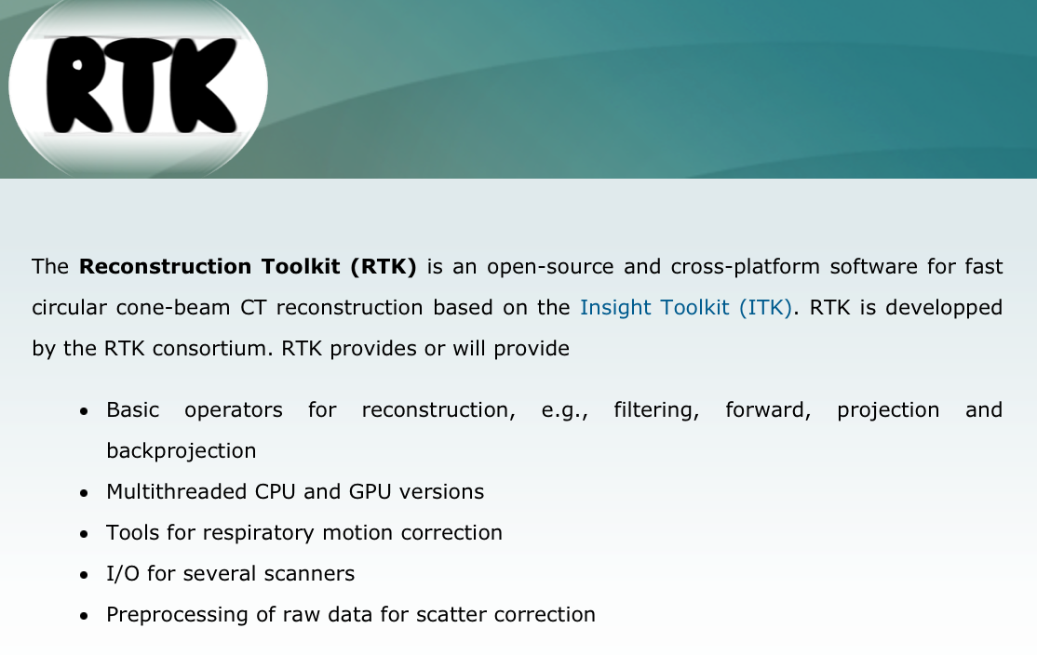
Cone Beam Reconstruction
OpenRTK, based on ITK
Developed in C++, but a Python wrapper library was built for Python development
RTK (beginning of term) was not supported with the version of ITK for Anaconda environments
Regular Python environment

Slide 24
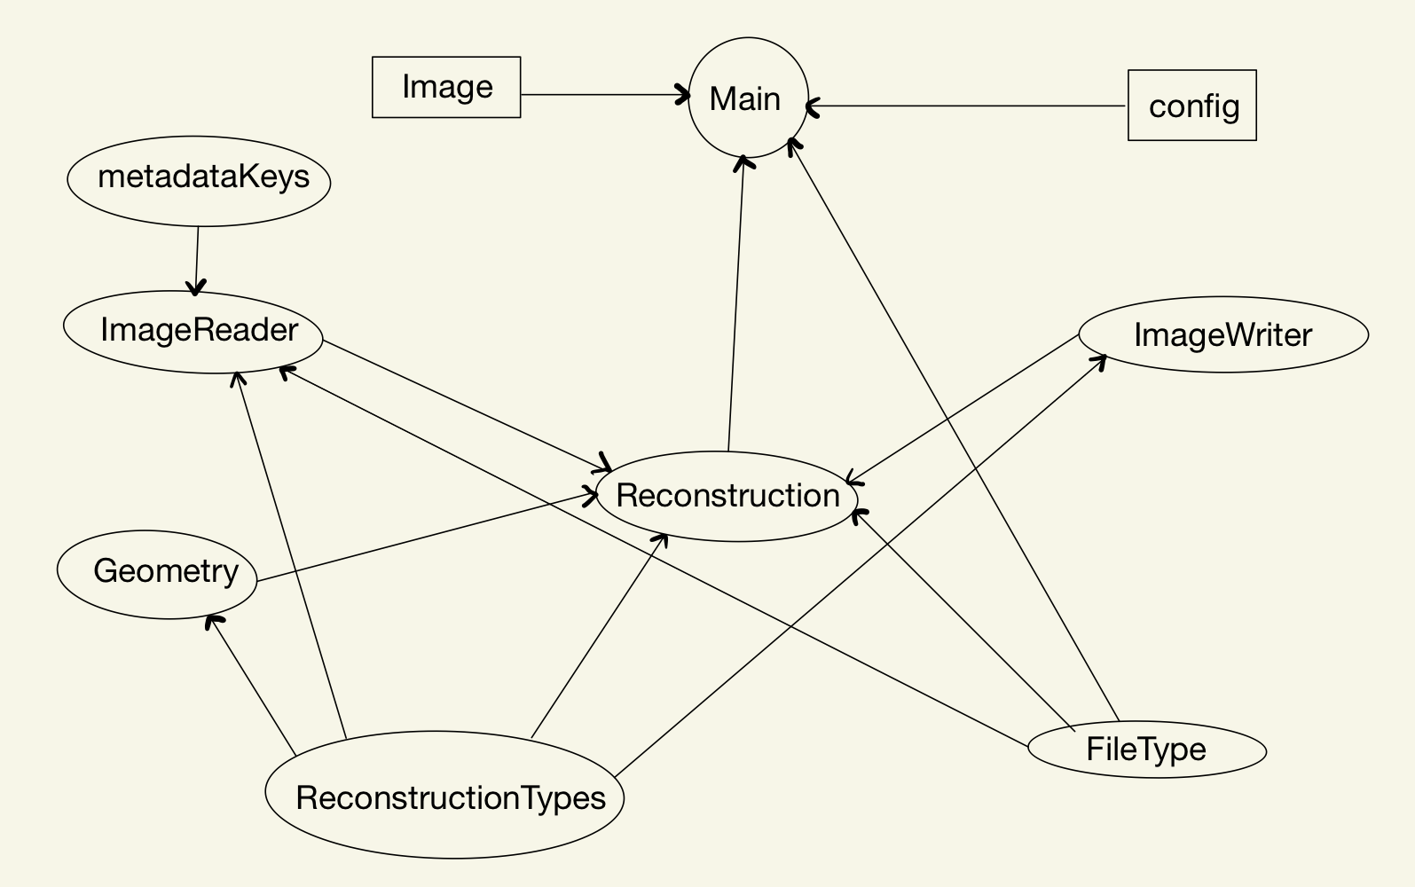
Reconstruction Algorithm
To use:
python main.py <DICOM directory> <spacing>
FDK (Feldkamp, Davis, Kress) cone beam reconstruction
Steps:
Read image, metadata
Create and save geometry
Pass image and geometry to reconstruction filter
Write image

Slide 25
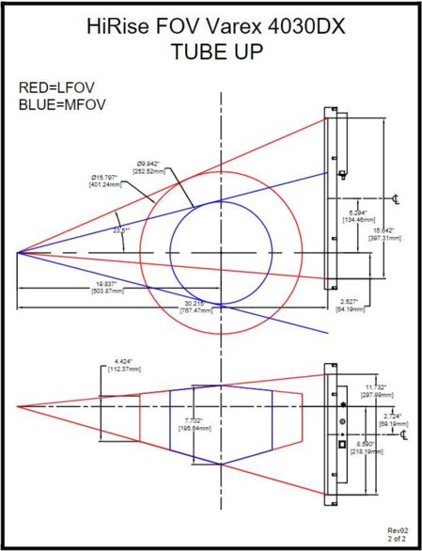
Reconstruction Algorithm Cont’d
A geometry object is created: holds angles at which X-rays are projected, source-to-isocenter distance (SID), source-to-detector distance (SDD), detector offsets
A blank image is constructed with calculated size, calculated origin, and custom spacing is created
FDK reconstruction: based on filtered backprojection
Back projects sinogram data onto blank image
Notes:
Label diagram

Slide 26
Reconstruction Class
The Reconstruction class includes the attributes: image directory, file type, static configuration, dynamic configuration, save directory, reader, writer, and filename.
Methods: reconstruct, createImage, getOutputSize, getOutputOrigin, getProjectionImages, setWriter, displacedDetectorImageFilter, parkerShortScanImageFilter, fdkReconstructionImageFilter, fieldOfViewMask
Algorithm currently uses displace detector image filter and FDK cone beam reconstruction filter.

Slide 27
Classes
Geometry: creates geometry object and writes to XML
ImageReader: reading in DICOM series and metadata from header
ImageWriter: writes image to NIfTI and MHA
ReconstructionTypes: types for certain filters
FileType: enumeration of some file suffixes
metadataKeys: keys for dynamic config

Slide 28
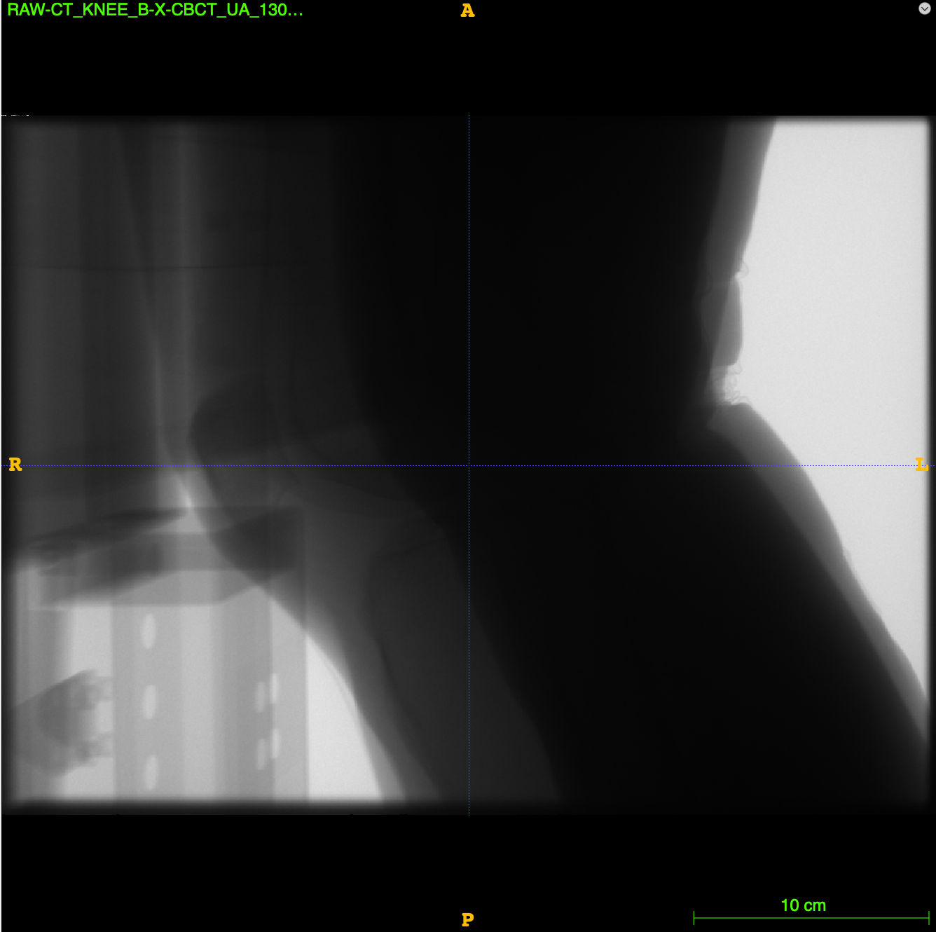
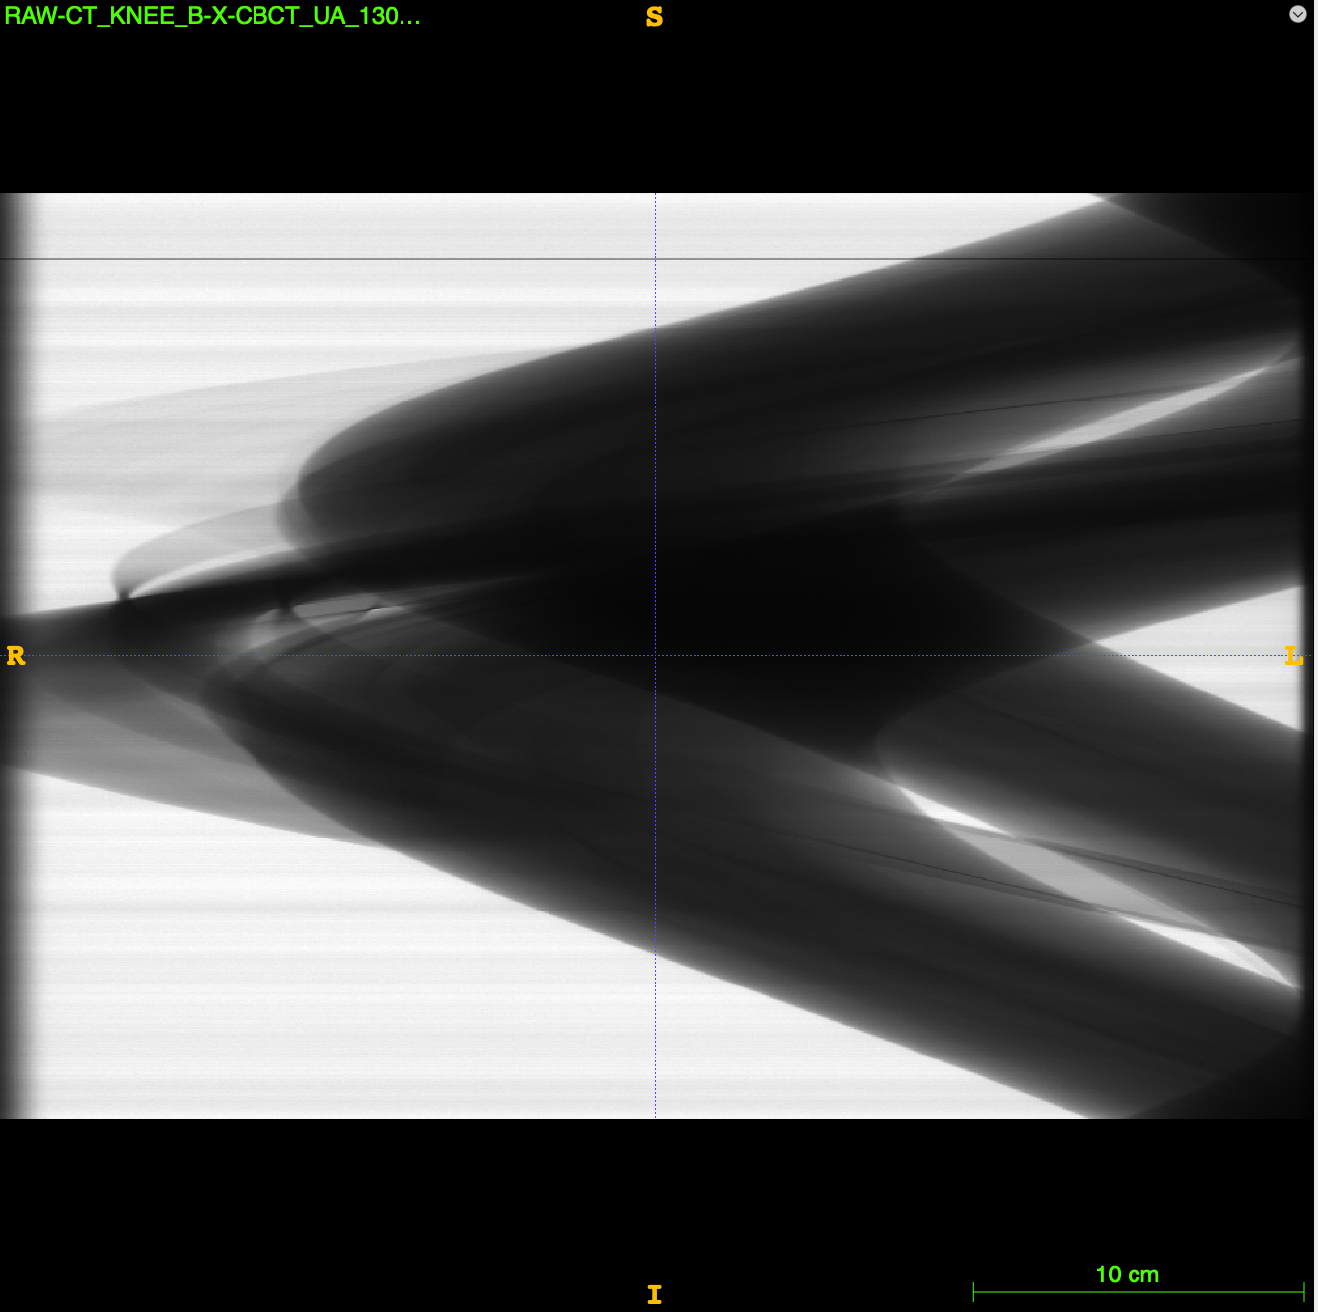
Sinogram

Slide 29
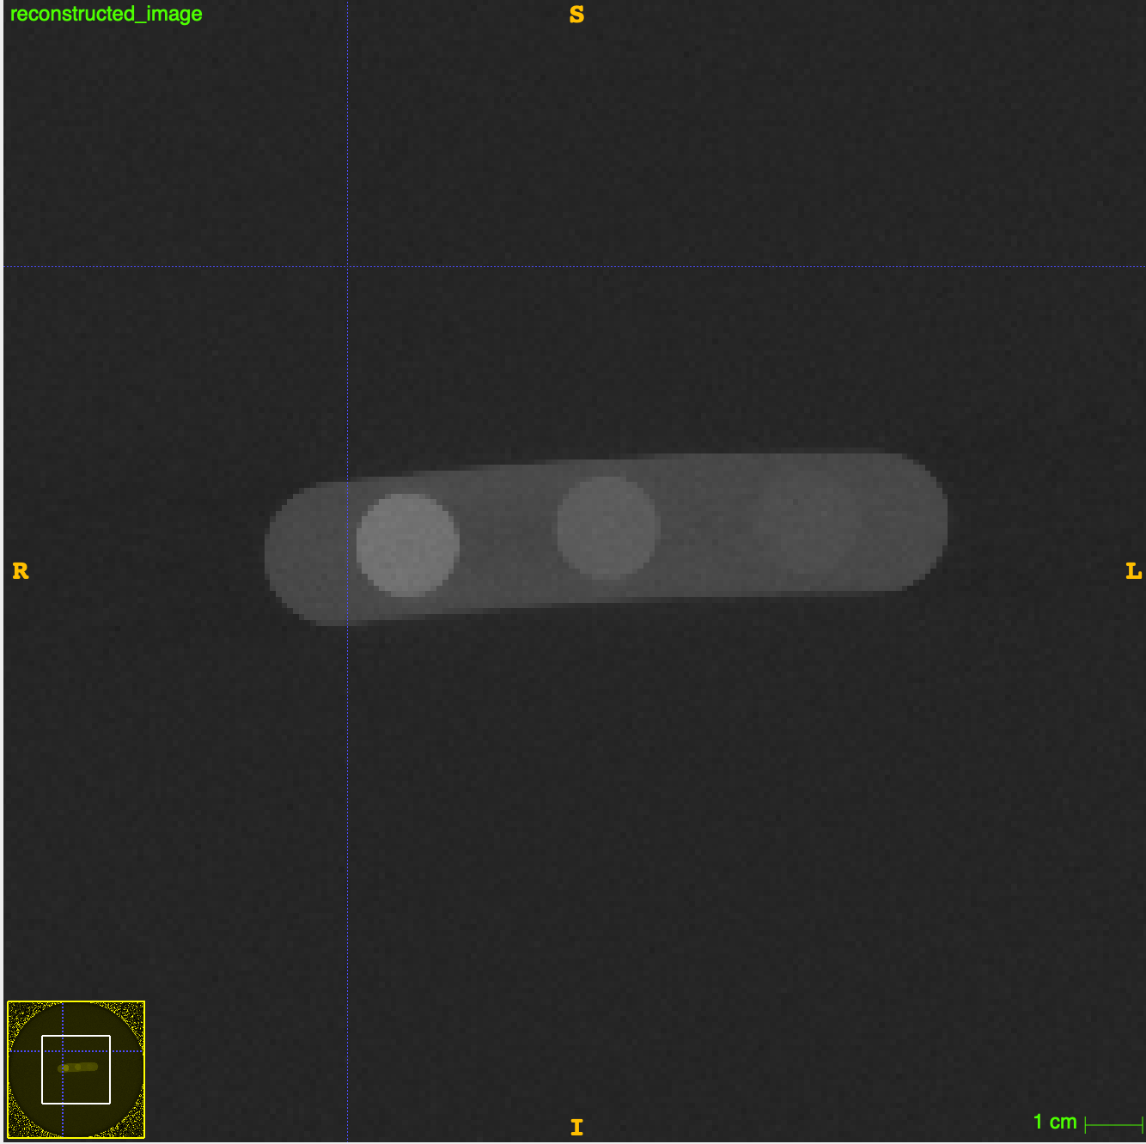
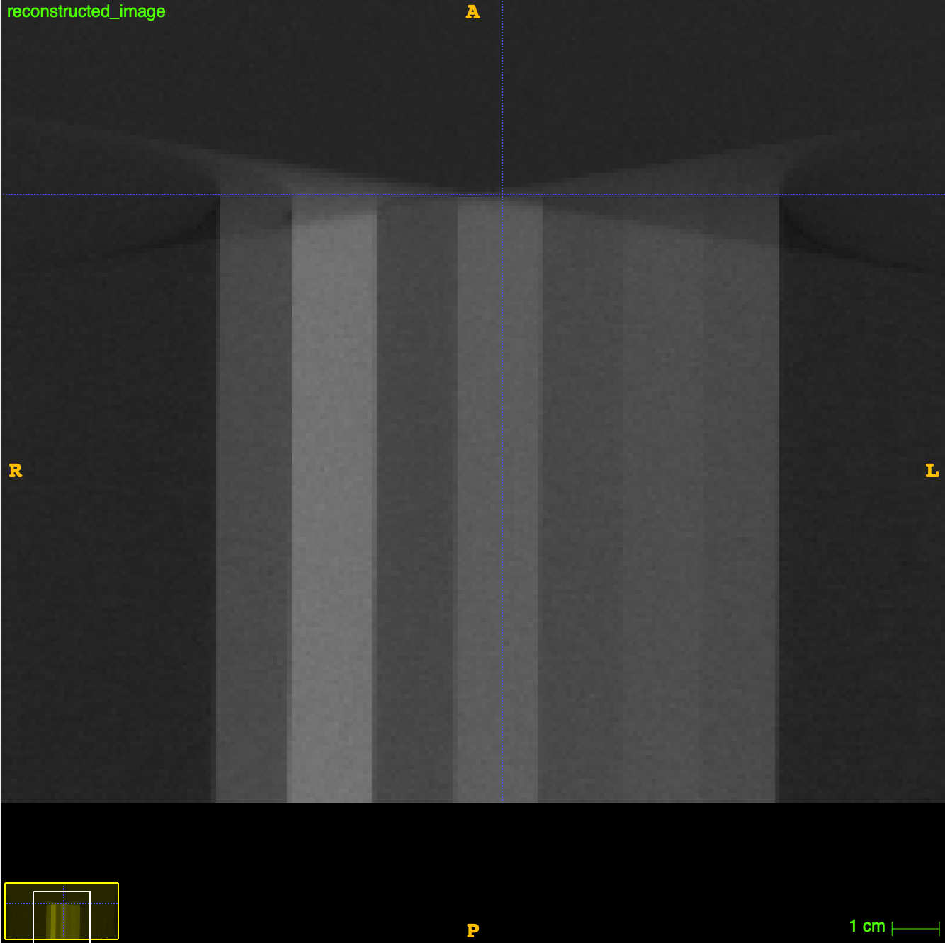
BMD Phantom Reconstruction
BDC Phantom
RTK Reconstruction Algorithm

Slide 30
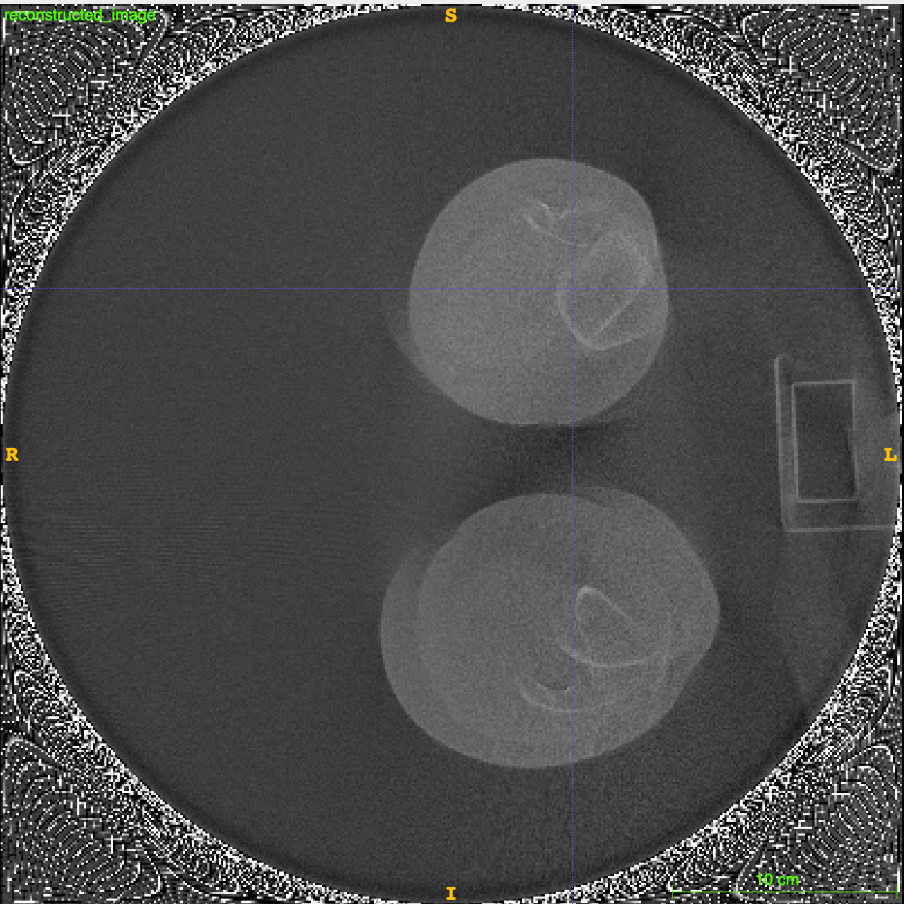
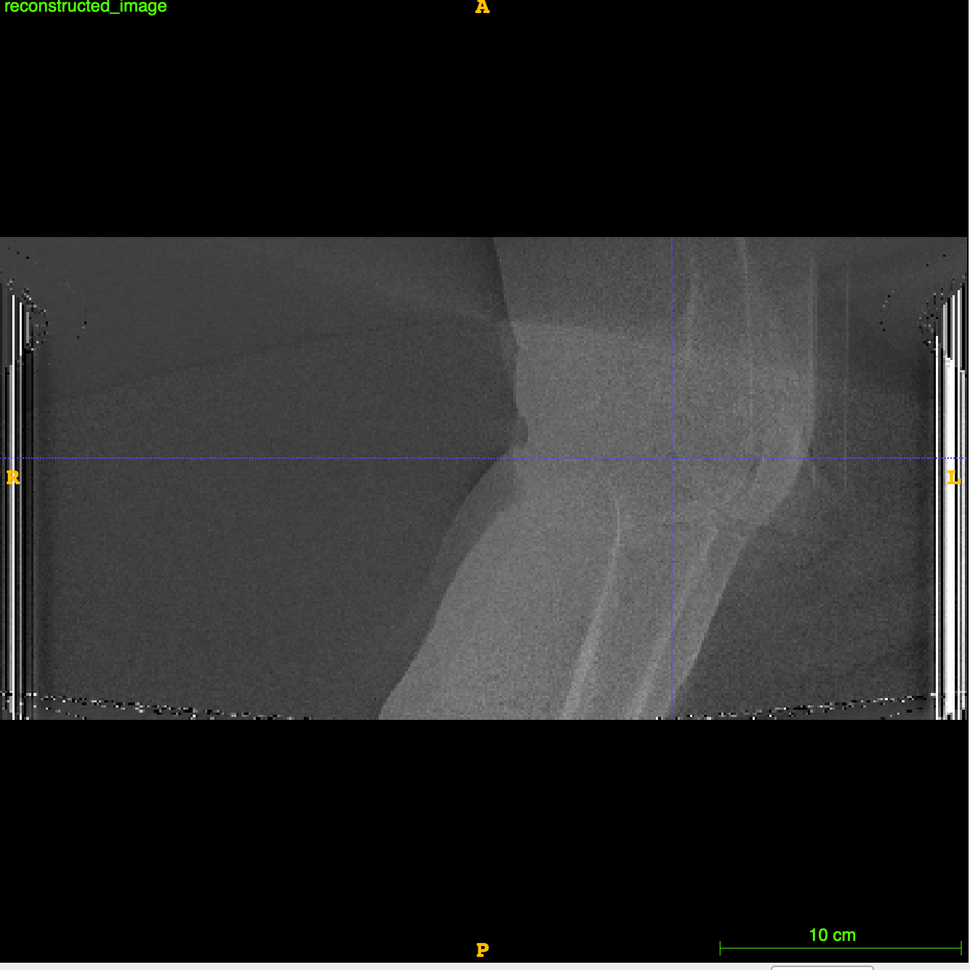
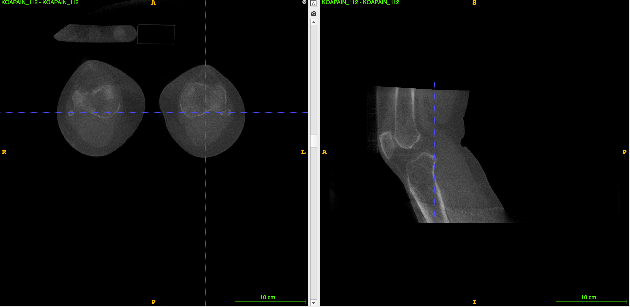
Knee Reconstructions KOAPAIN 112
<- My reconstruction
CurveBeam reconstruction ->

Slide 31
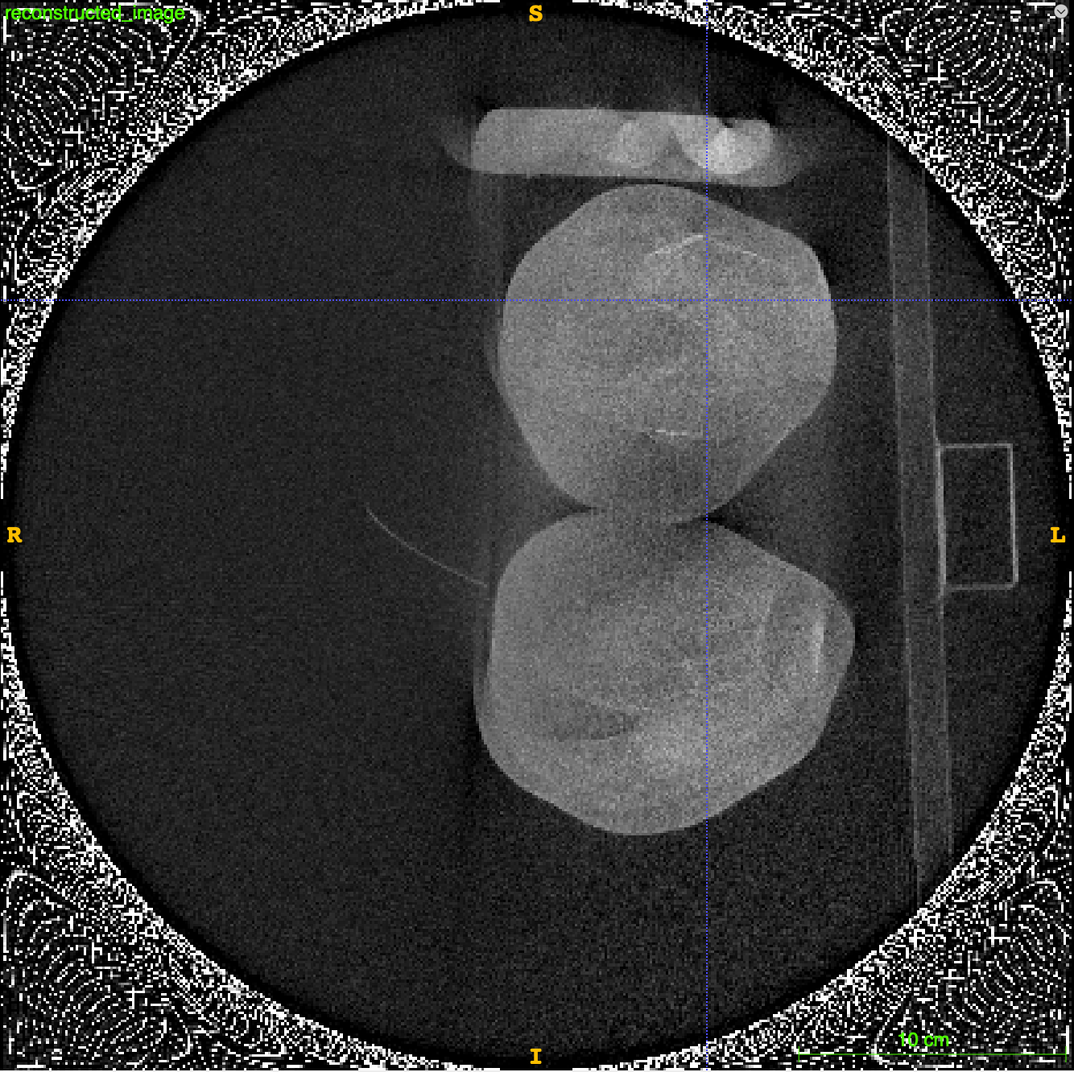
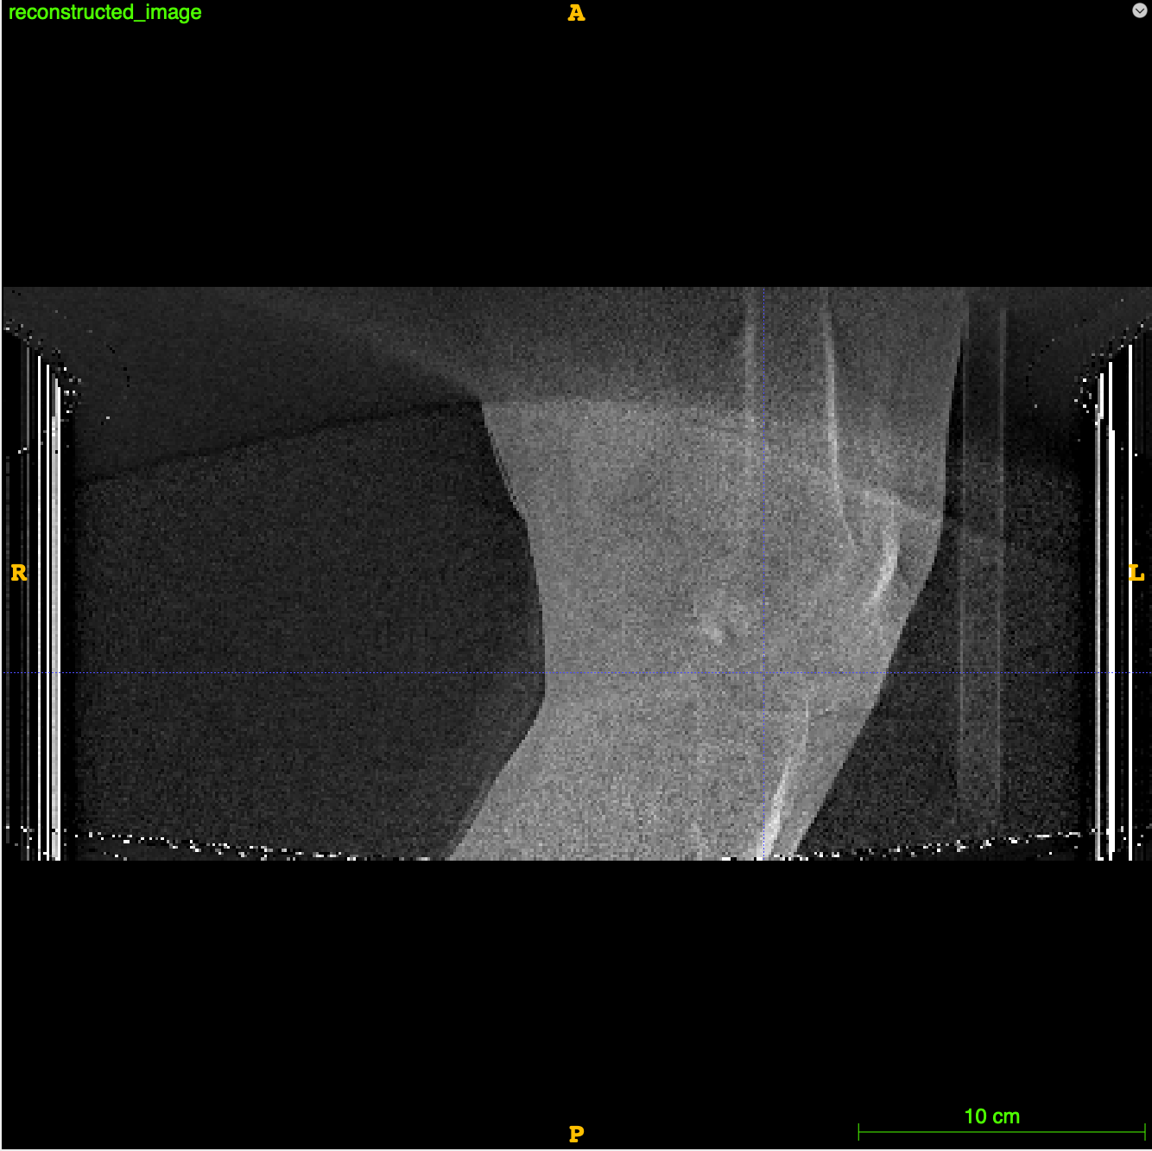
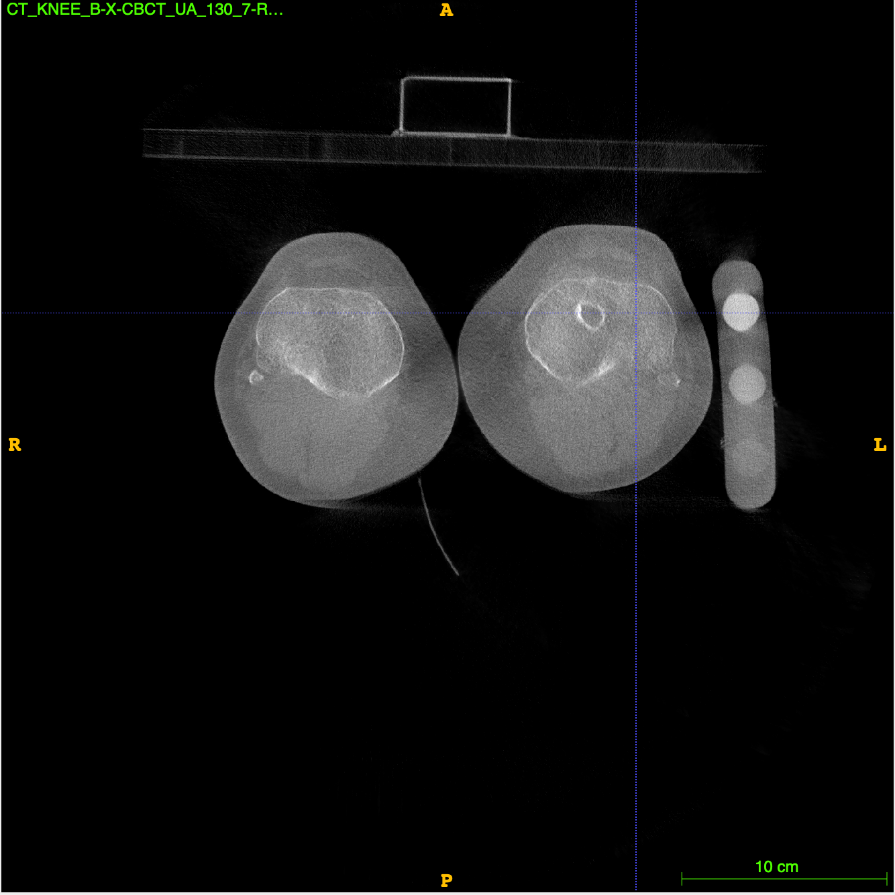
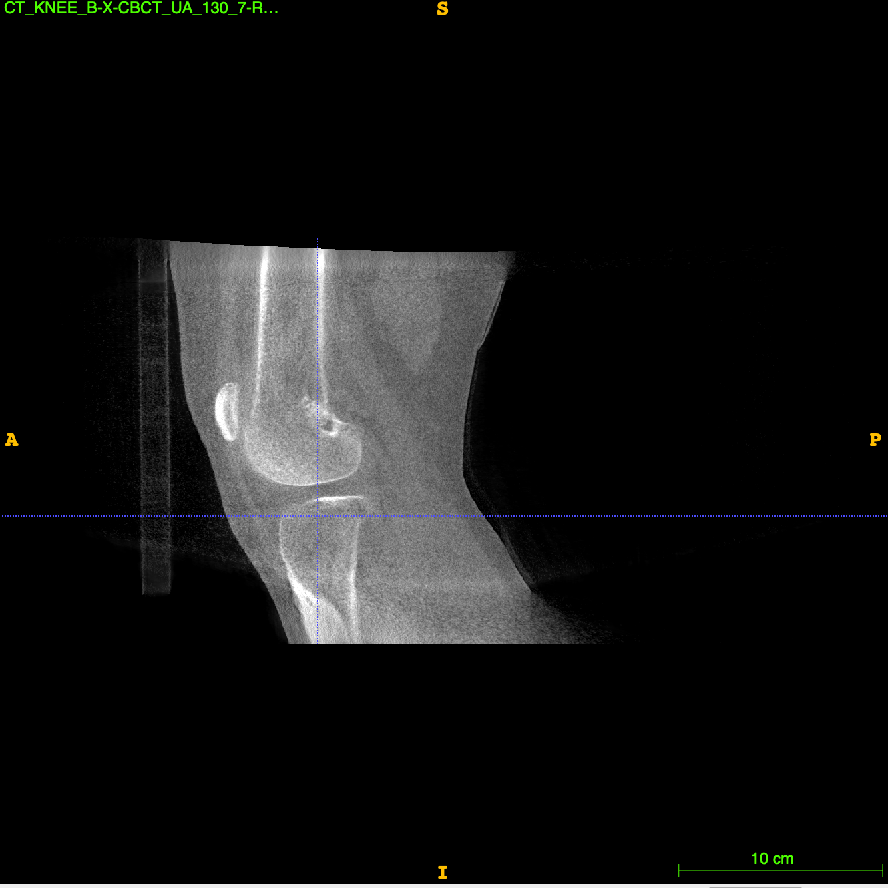
PKOA 080 Knee Reconstruction
My reconstruction
CurveBeam reconstruction ->

Slide 32
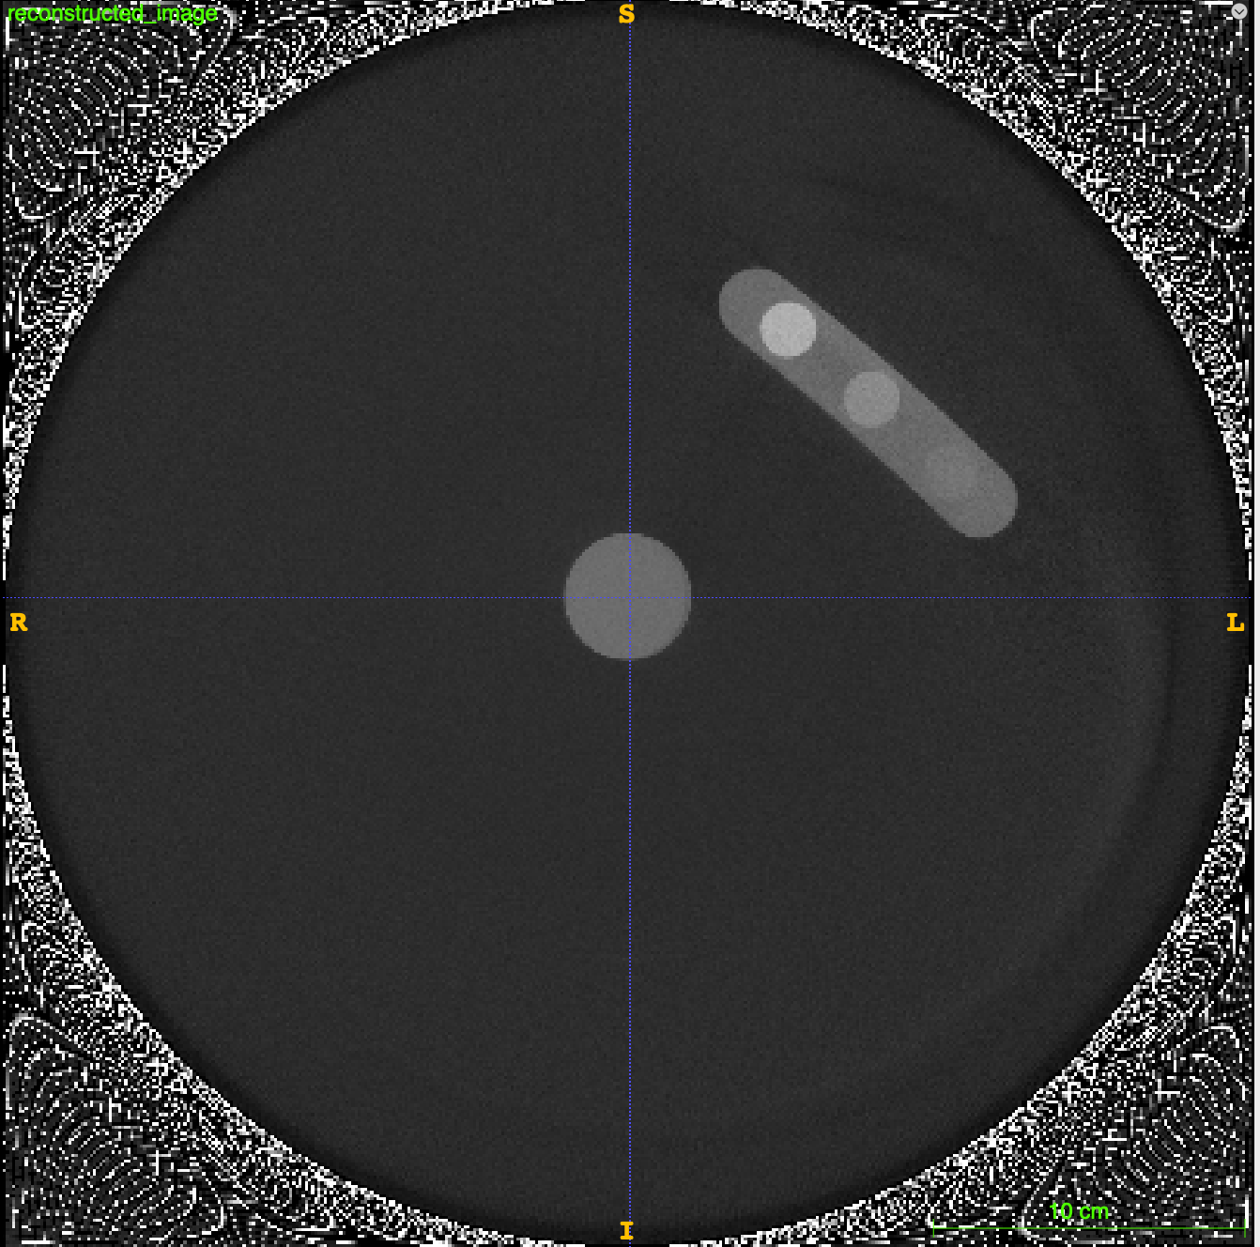
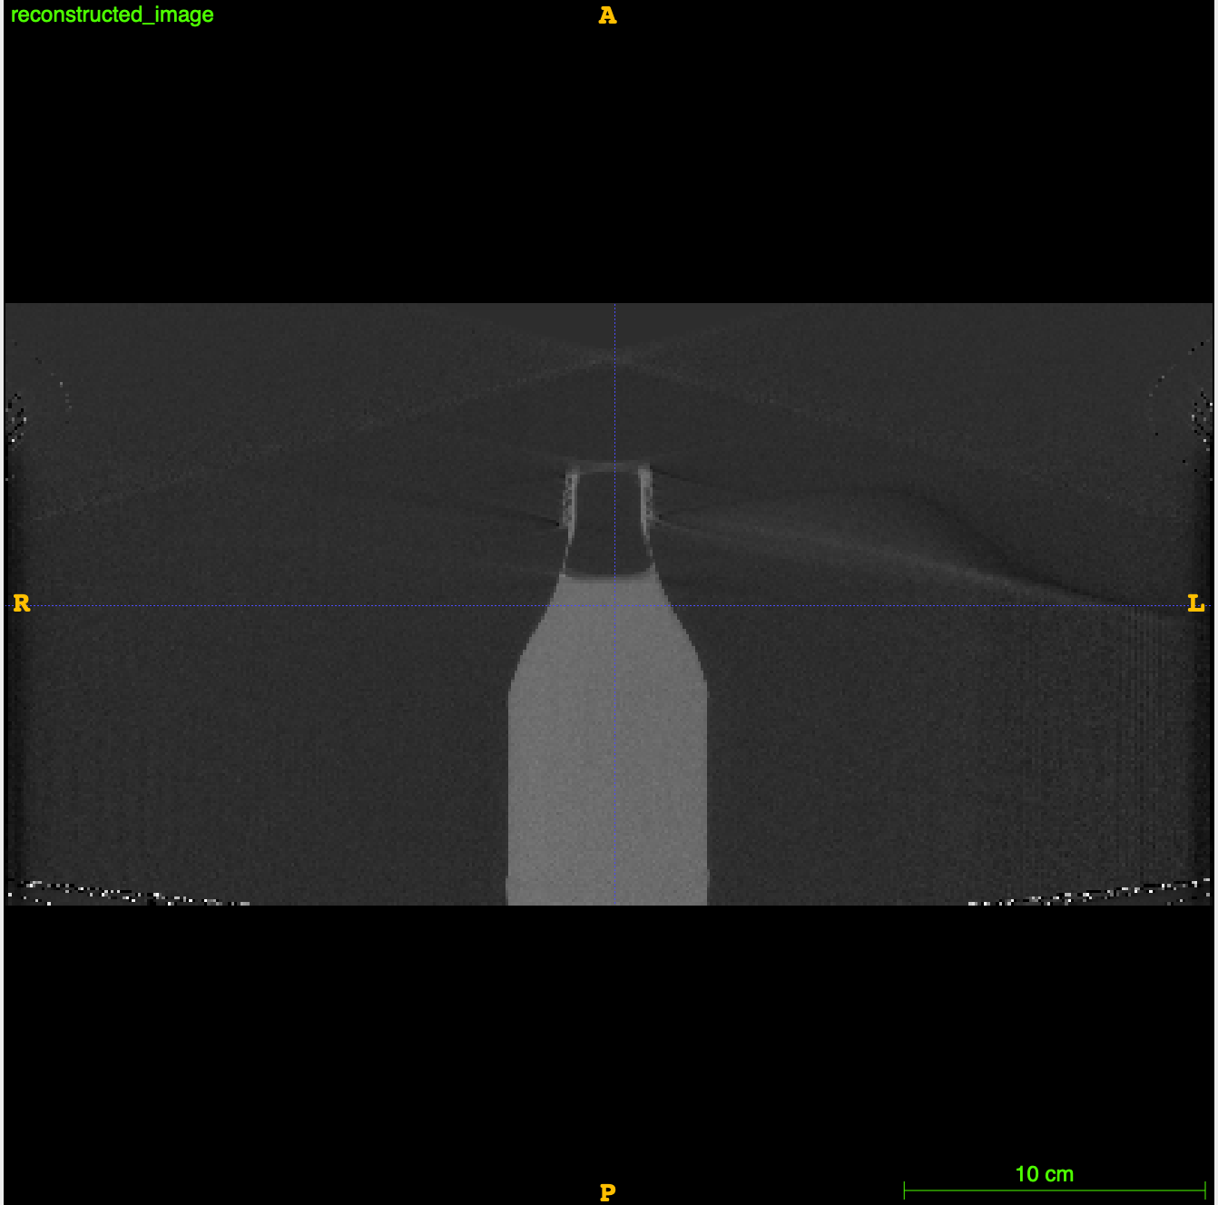
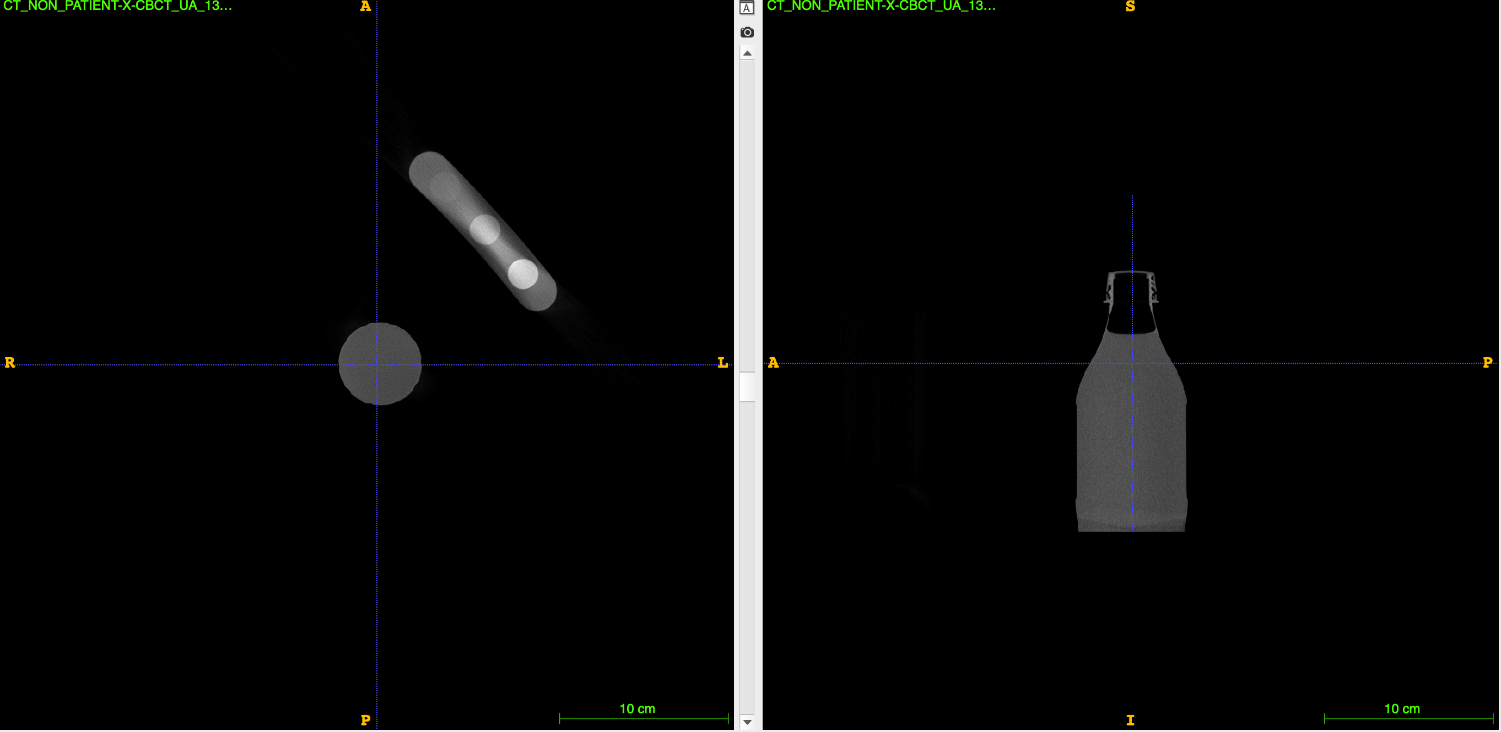
Research Protocol (home position)
<- My reconstruction (coke bottle and phantom)
CurveBeam reconstruction ->

Slide 33
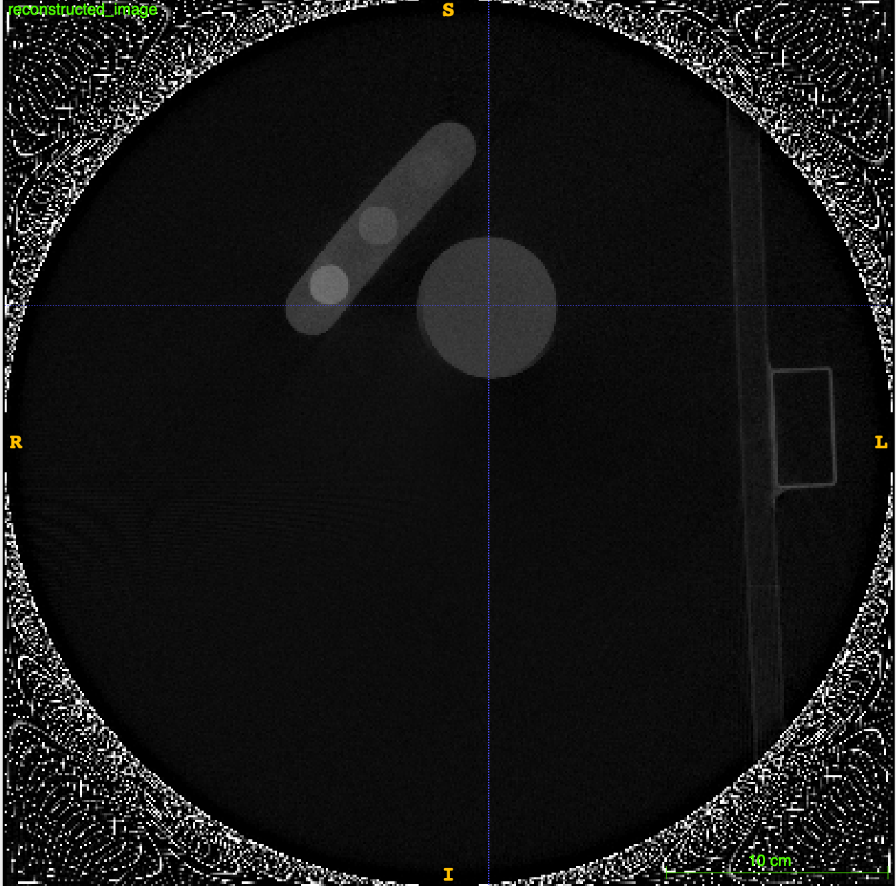
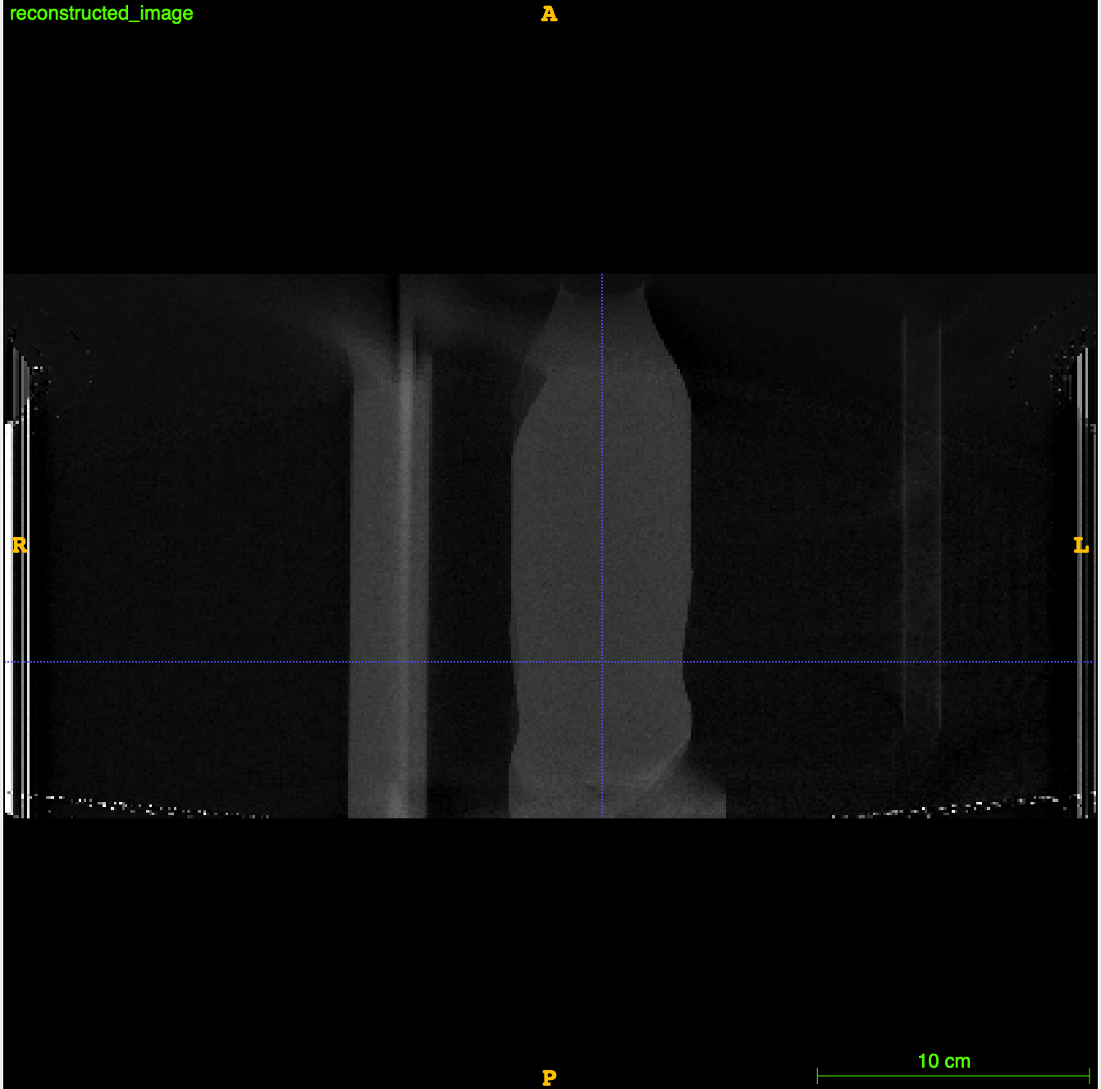
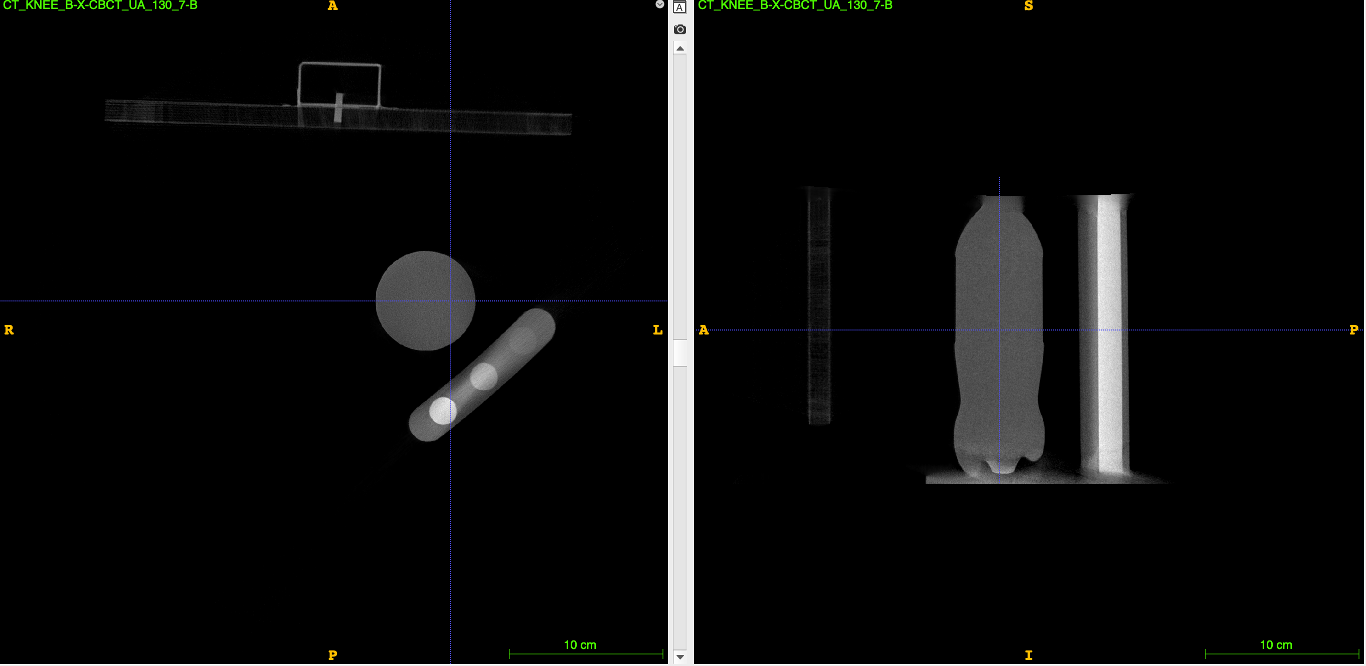
Knee Protocol
<- My reconstruction
CurveBeam reconstruction ->

Slide 34
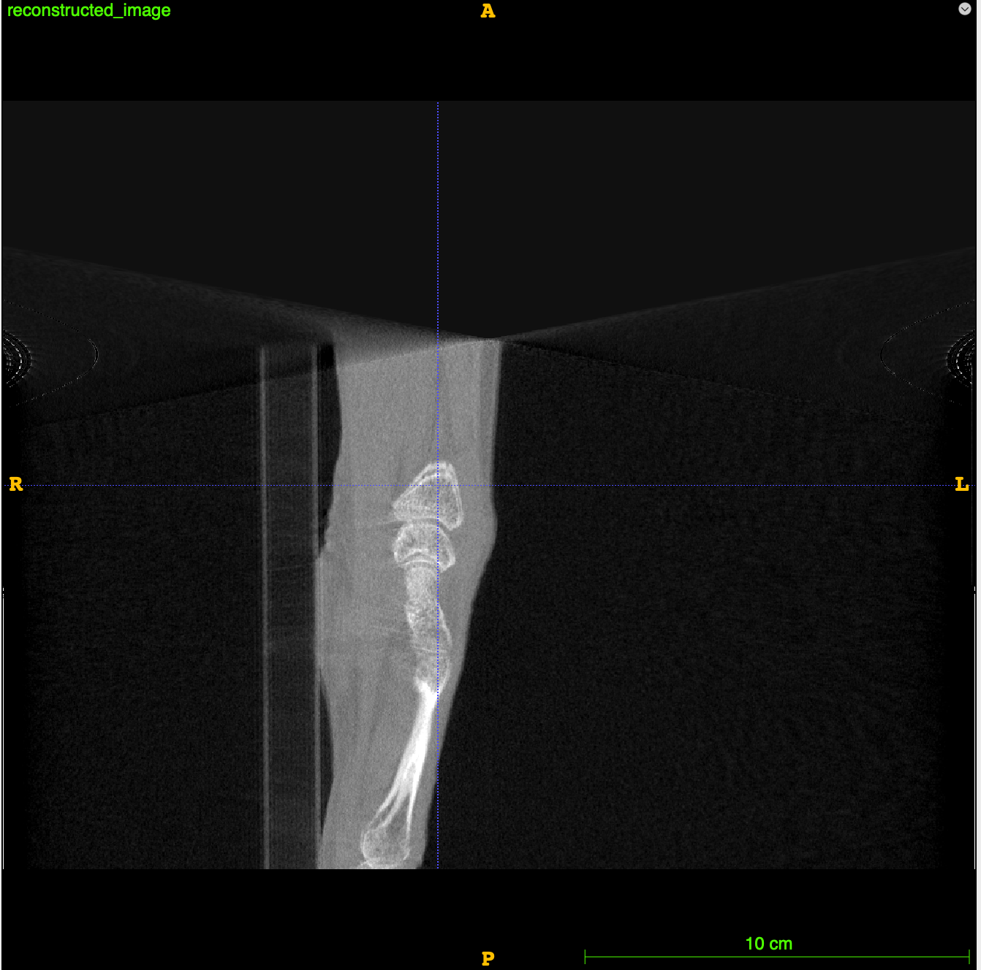

Hand Scan
Medium FOV, Detector offset = 0, 0

Slide 35

Hand Scan
Detector offsets from metadata
Detector offset = 0.42,-67.59

Slide 36

My Feet/Ankle – Home Position (Tube Down)

Slide 37

Discoveries
Only need to choose spacing, everything is fixed
$origin=−\frac{1}{2}\left(spacing\right)\left(size −1\right)$
$size=gantrySize/spacing$ where gantrySize = (401, 401, 200)
SID, SDD, projection size and spacing, and detector offset is in metadata
Detector offset is encoded in 6 bits of data by CurveBeam
Decode to UTF-8 (Unicode)
Different output image origin depending on tube up/down

Slide 38
Acknowledgements
Dr. Sarah Manske
Tadiwa Waungana
Dr. Justin Tse
Reconstruction helpers
Simon Rit
Kevin Dibbern
Don Anderson
CurveBeam team
All lab members

Slide 39
Questions?
Keven Qiu
keven.qiu@uwaterloo.ca

Slide 40


Connected Component Labeling Algorithm
An (undirected) graph G=(V,E) consists of a set of vertices and a set of unordered pairs of vertices called edges
Images can be transformed into a graph
Each voxel is a vertex and adjacent voxels are connected by an edge
Want to find number of regions in an image which have a certain label
Graph
Image graph
Notes:
Move to extras

Slide 41

Connected Component Labeling Algorithm
First solution: graph traversal (breadth/depth-first search)
When iterating through the image, once found a vertex (voxel) with label x, search until x is not found
Implemented in cclDFS3D.py
Can visit lots of “visited” vertices in the graph
<- DFS
1. https://codeforces.com/blog/entry/68138

Slide 42

Connected Component Labeling Algorithm Cont’d
Second method: Disjoint Set data structure (Union-Find)
Idea: at the end of algorithm, the number of sets left is the number of connected components
Initialization: Give every vertex with label x its own set.
If a vertex in a set is connected to another vertex in a set, union the two sets
How to implement these sets for high efficiency?
1. https://en.m.wikipedia.org/wiki/File:UnionFindKruskalDemo.gif

Slide 43



Connected Component Labeling Algorithm Cont’d
Problem: Need to search through the entire set to check if two vertices are connected -> O(n)
Want each set to have an “identity” or “parent” (voxel location)
Instead of a random collection of vertices, organize into a multiway tree
The find() operation will find the parent of vertex v; if v’s parent isn’t equal to v, then set’s identity has not been reached, keep calling find()
find() needs to be efficient hence use tree -> O(log n)
When doing set union of A and B, assign parent of B as the parent of A
Want to merge/union two sets/trees, we want to merge the smaller “ranked” tree to the larger one, so we don’t need to update any ranks

